Slide 1
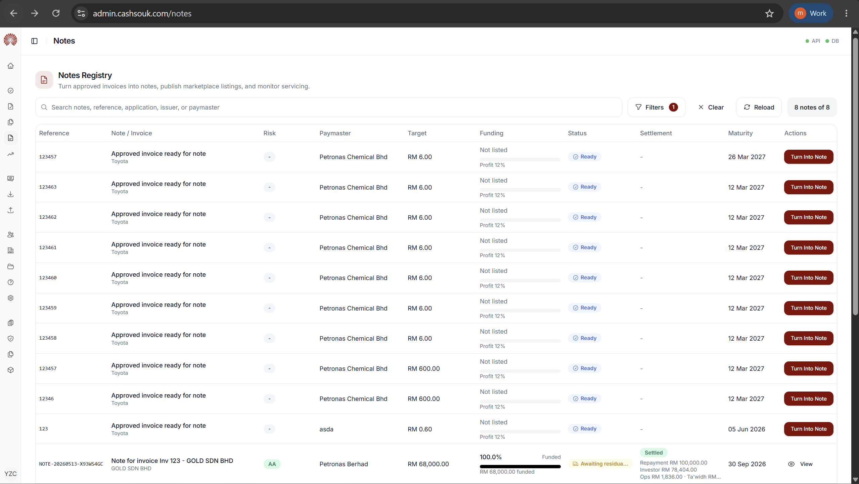
notes.view
notes.create

Slide 2
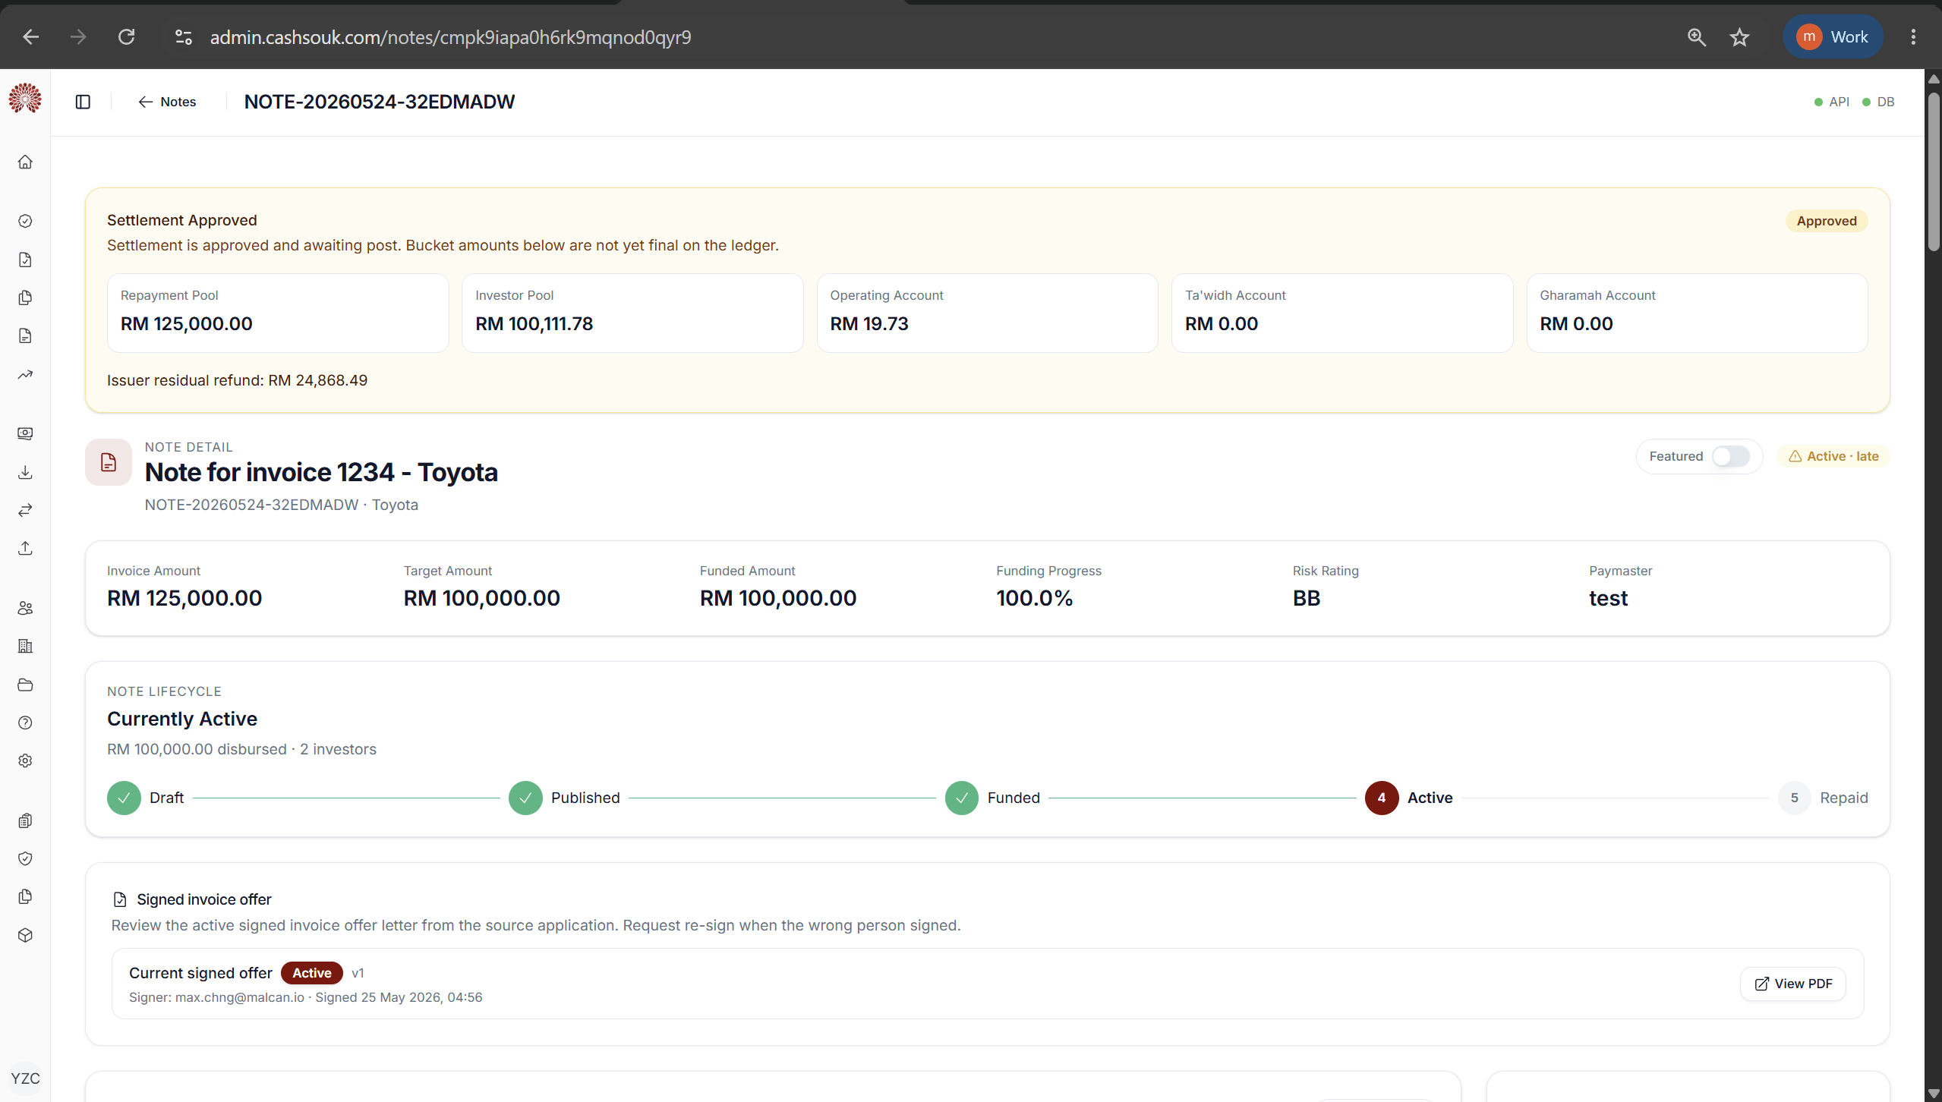
notes.view
notes.manage

Slide 3
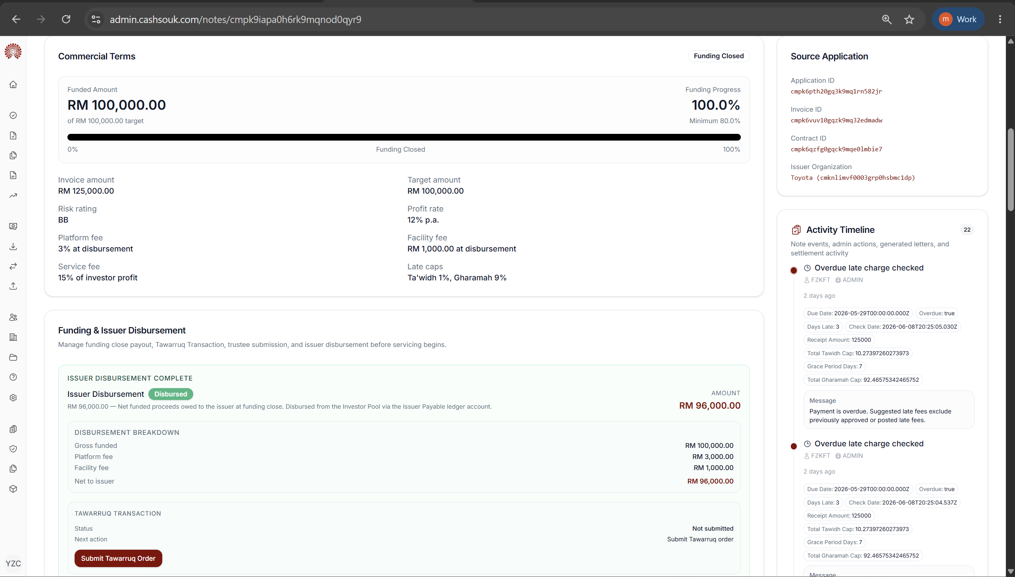
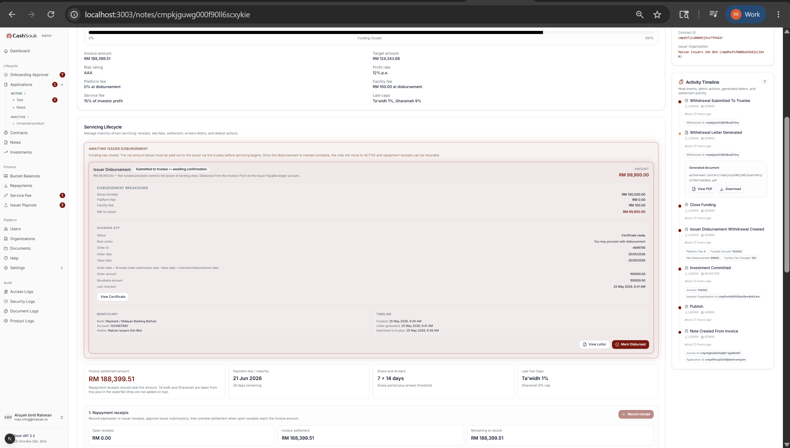
notes.view
notes.disbursement.manage

Slide 4
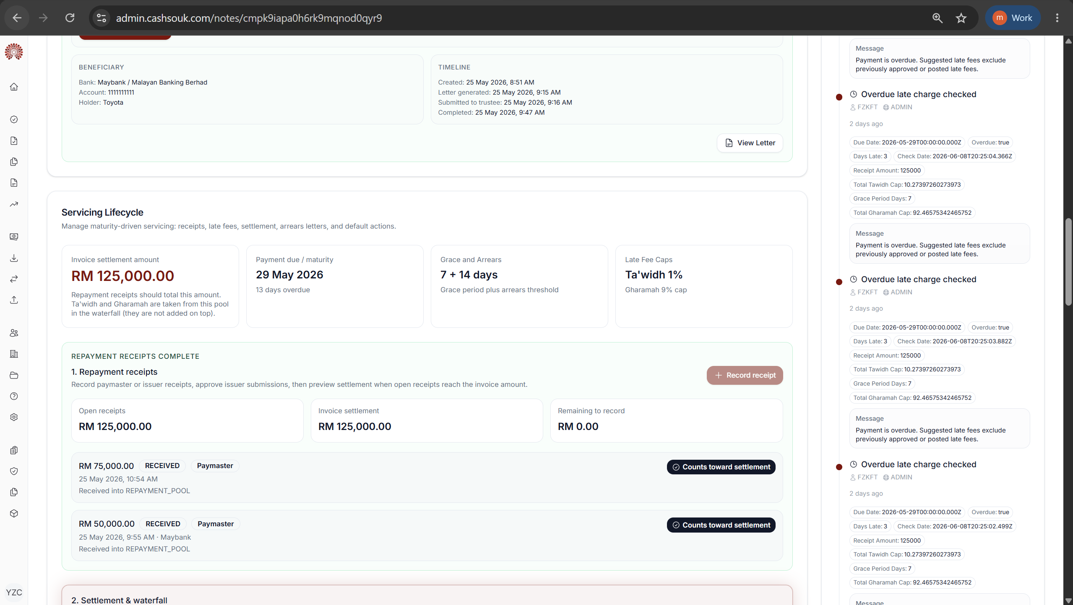
notes.view
notes.repayment.manage

Slide 5
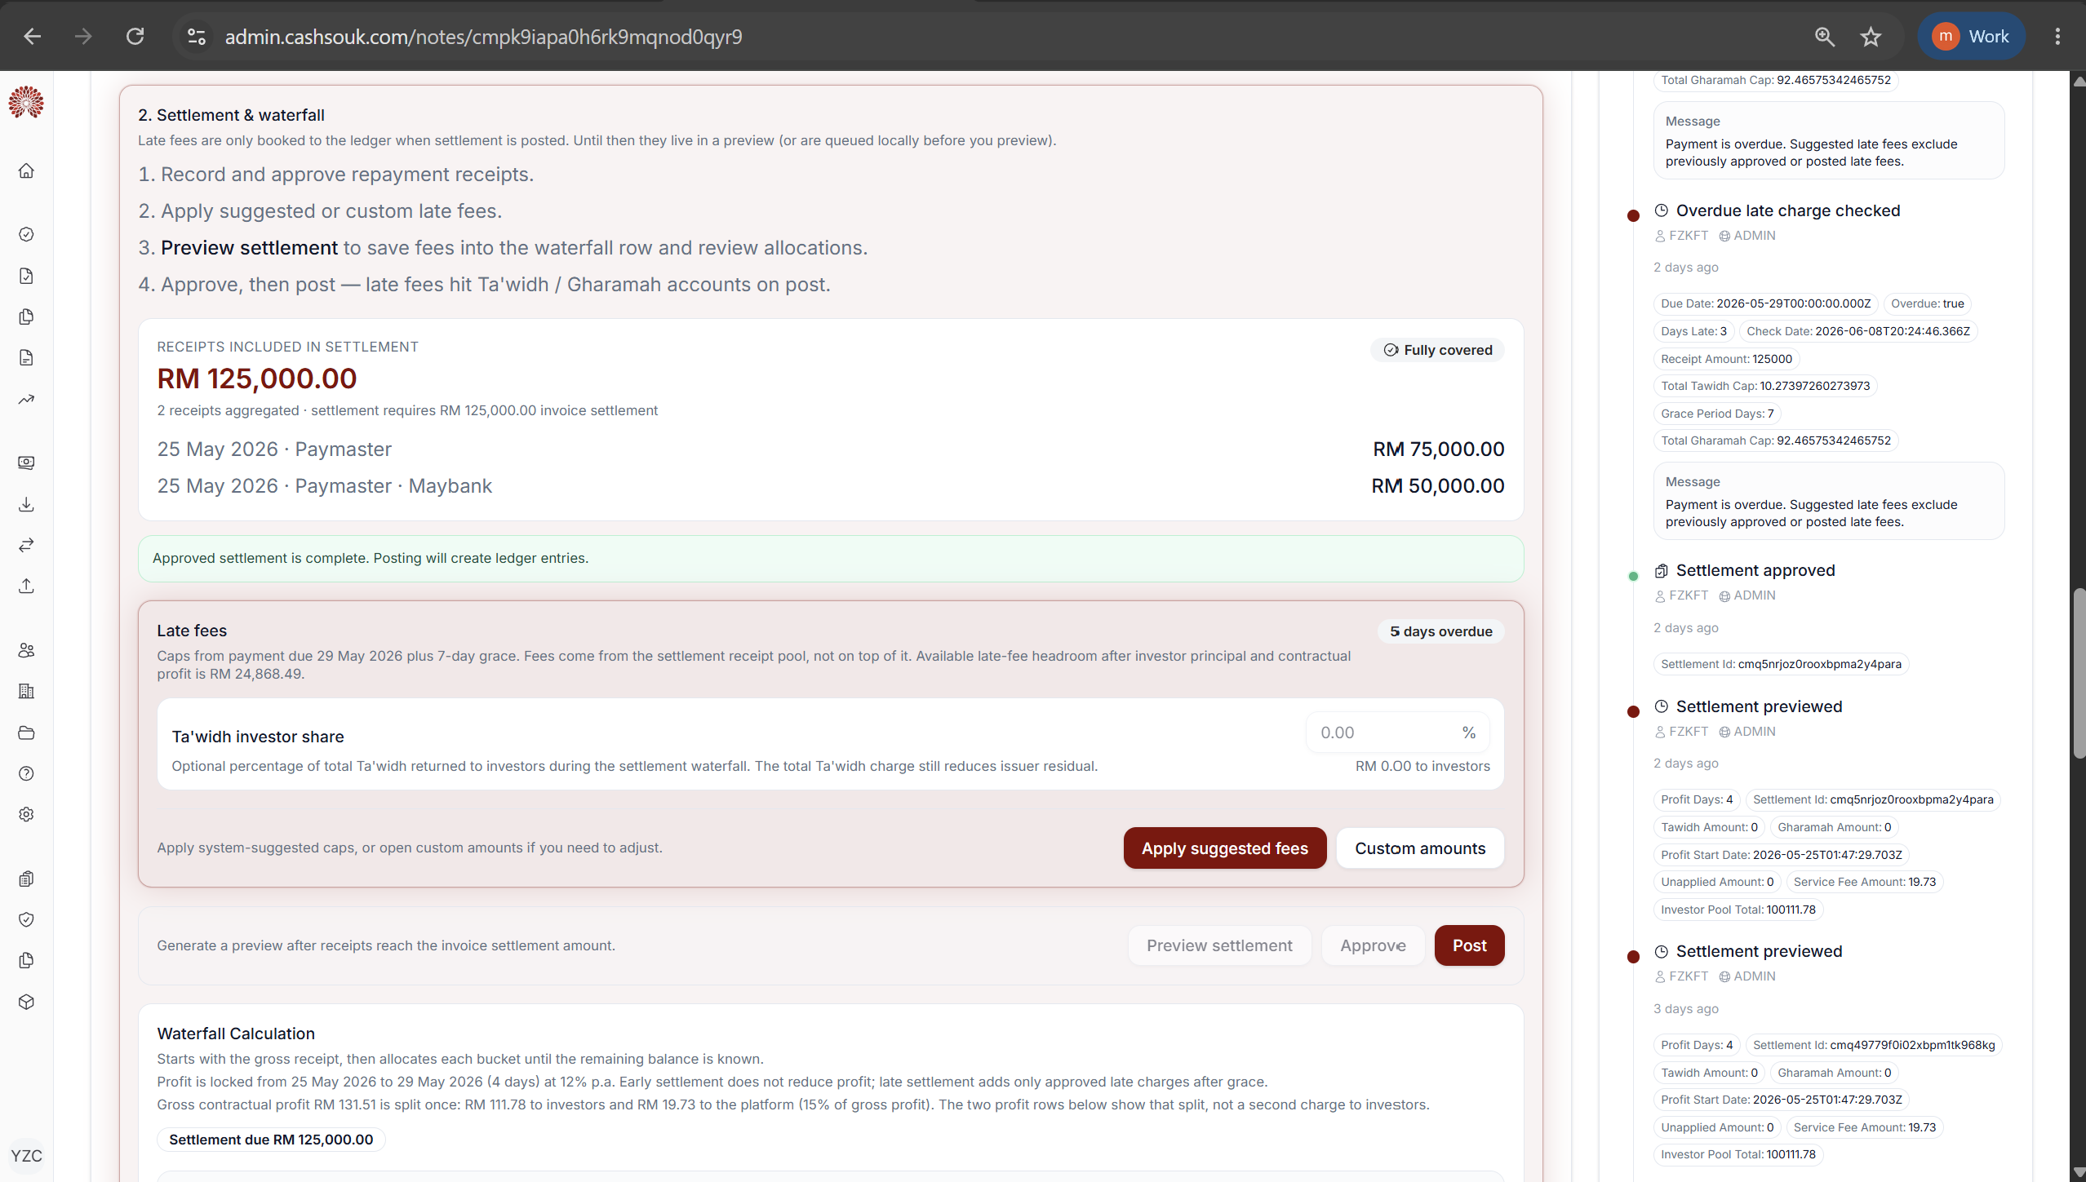
notes.view
notes.settlement.manage

Slide 6
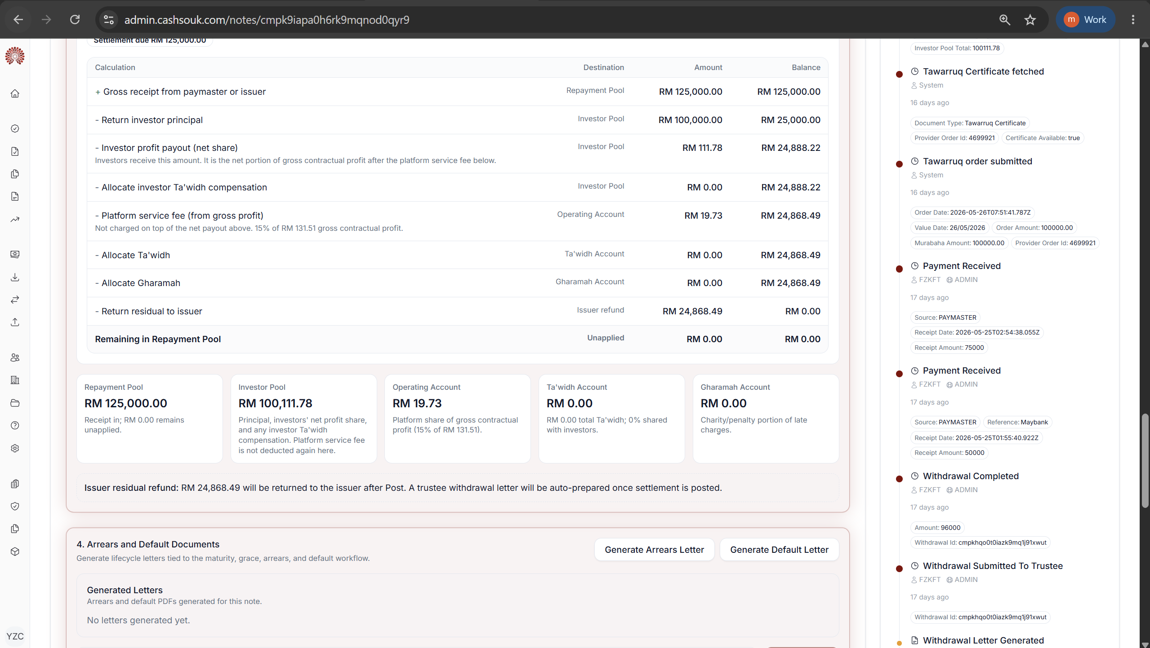
notes.view
notes.default.manage

Slide 7
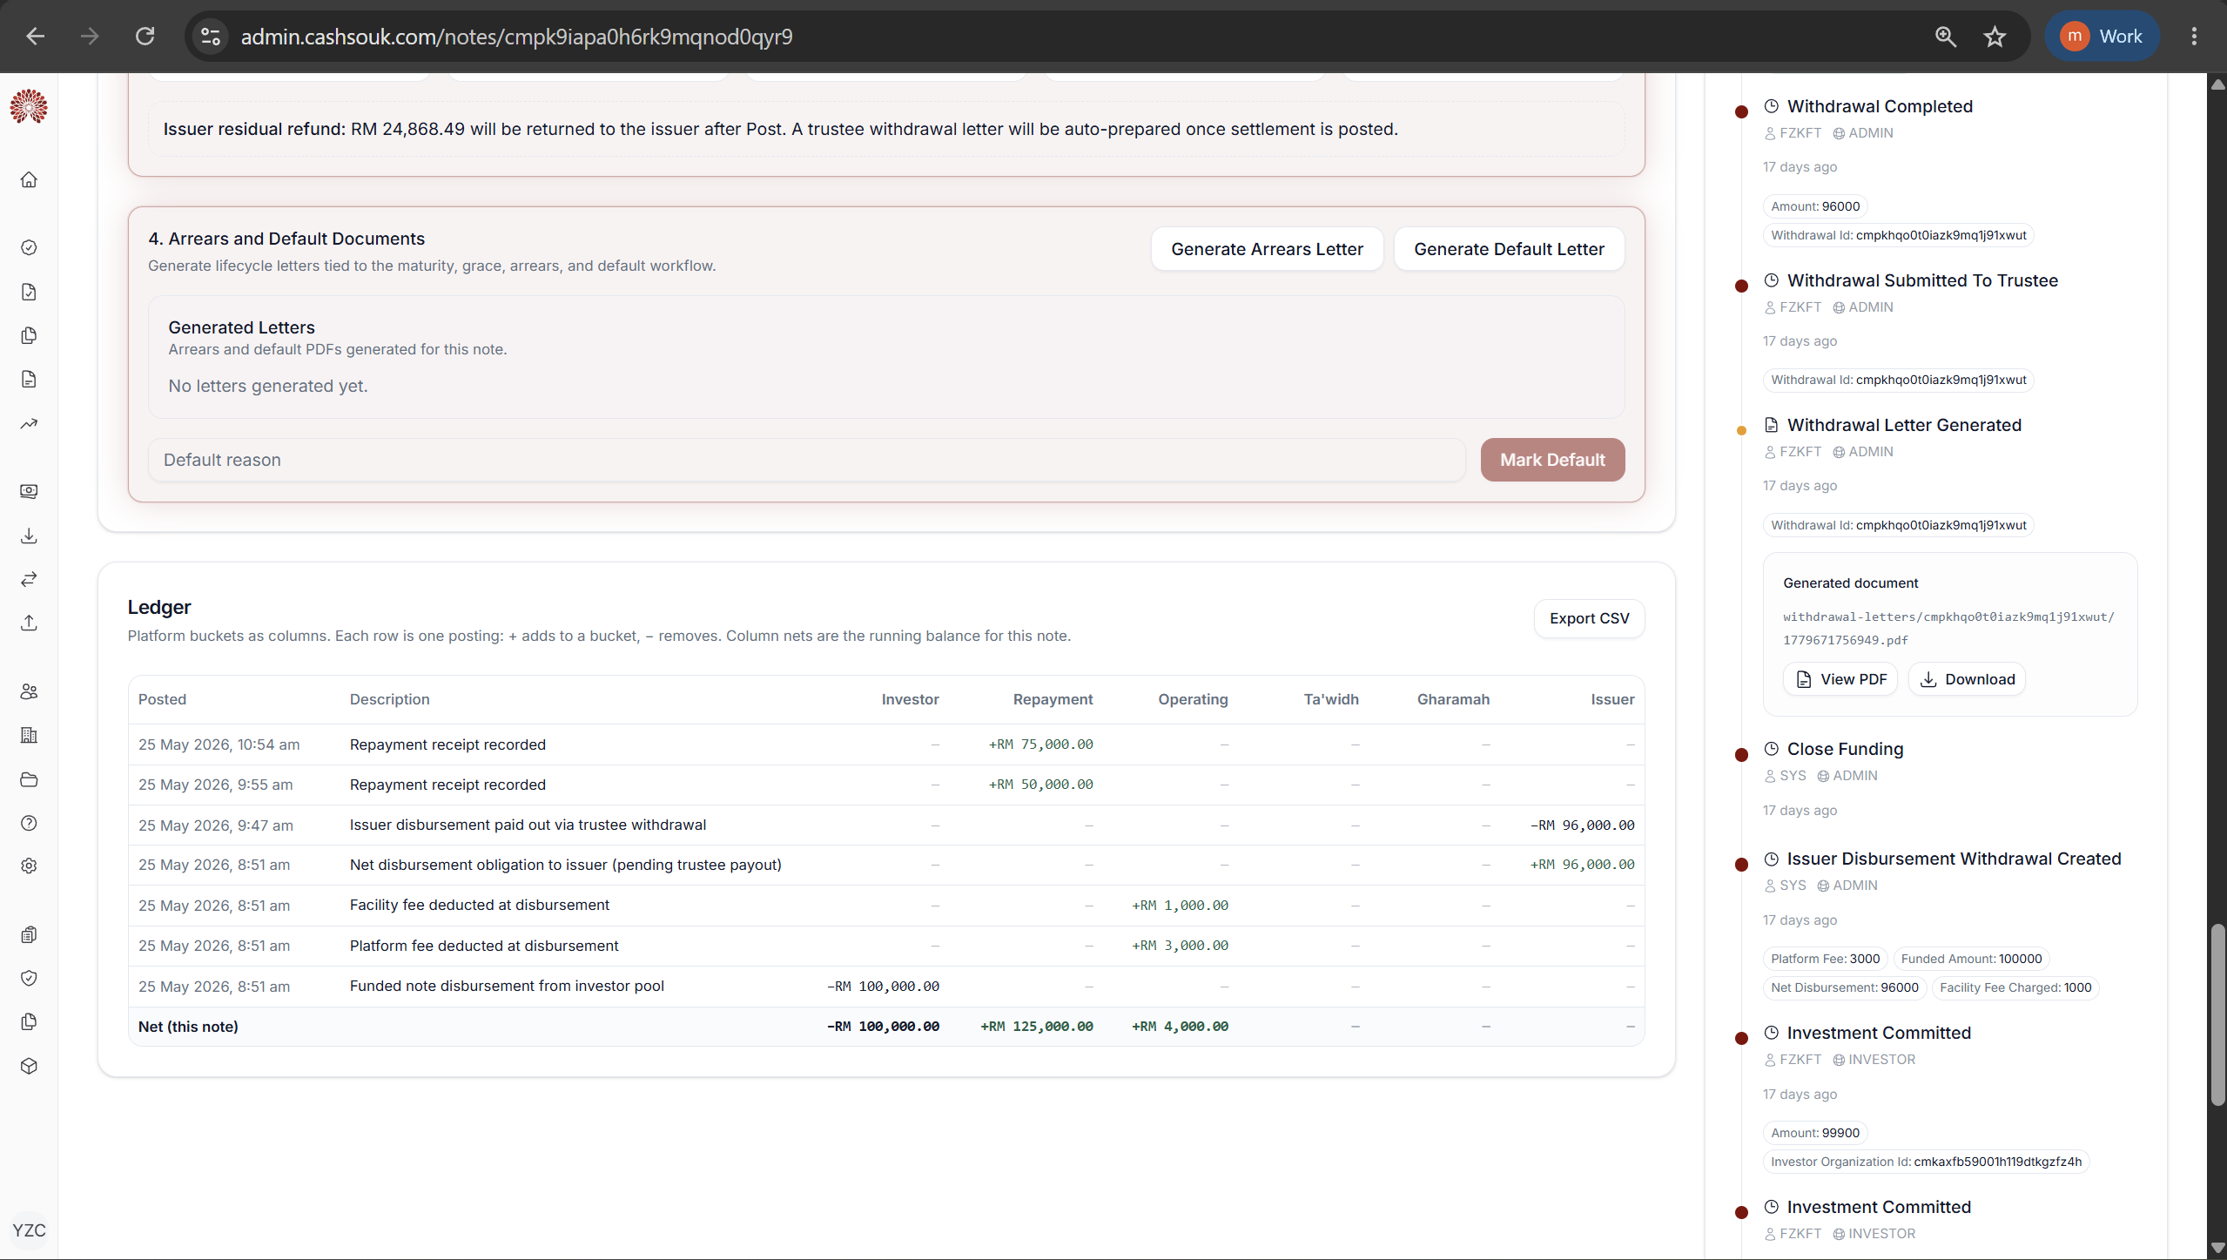
1
notes.view
notes.default.manage

Slide 8
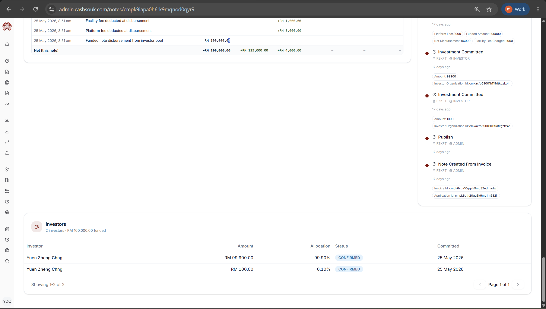
1
notes.view

Slide 9
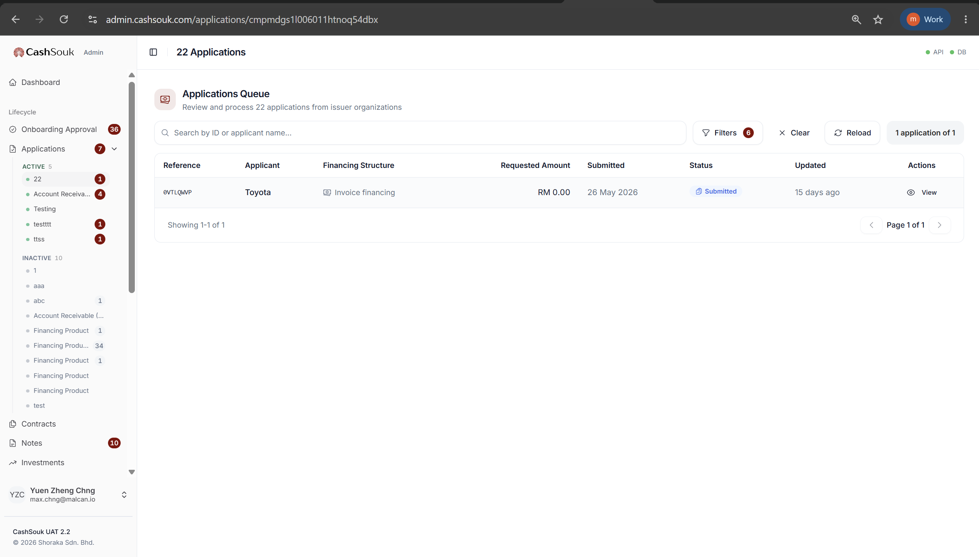
applications.view

Slide 10
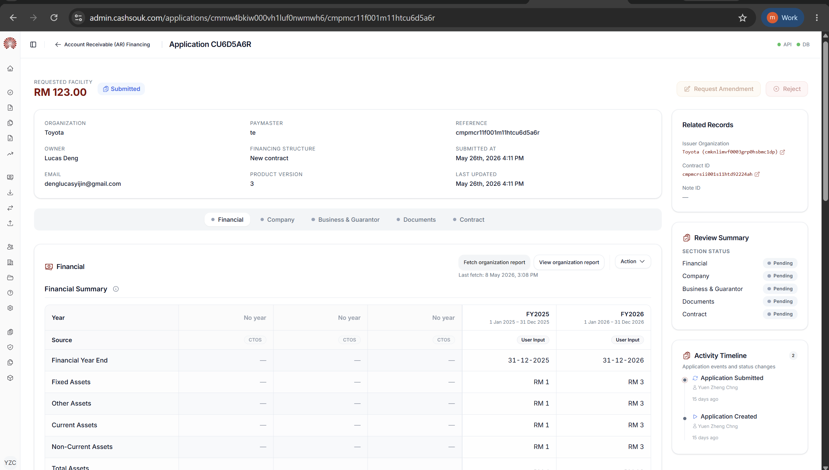
applications.manage
applications.view
applications.financial.manage

Slide 11
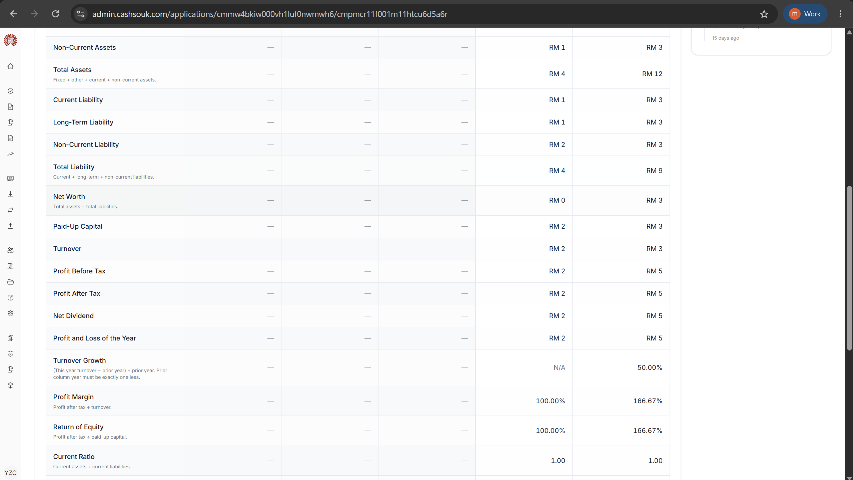
applications.view

Slide 12
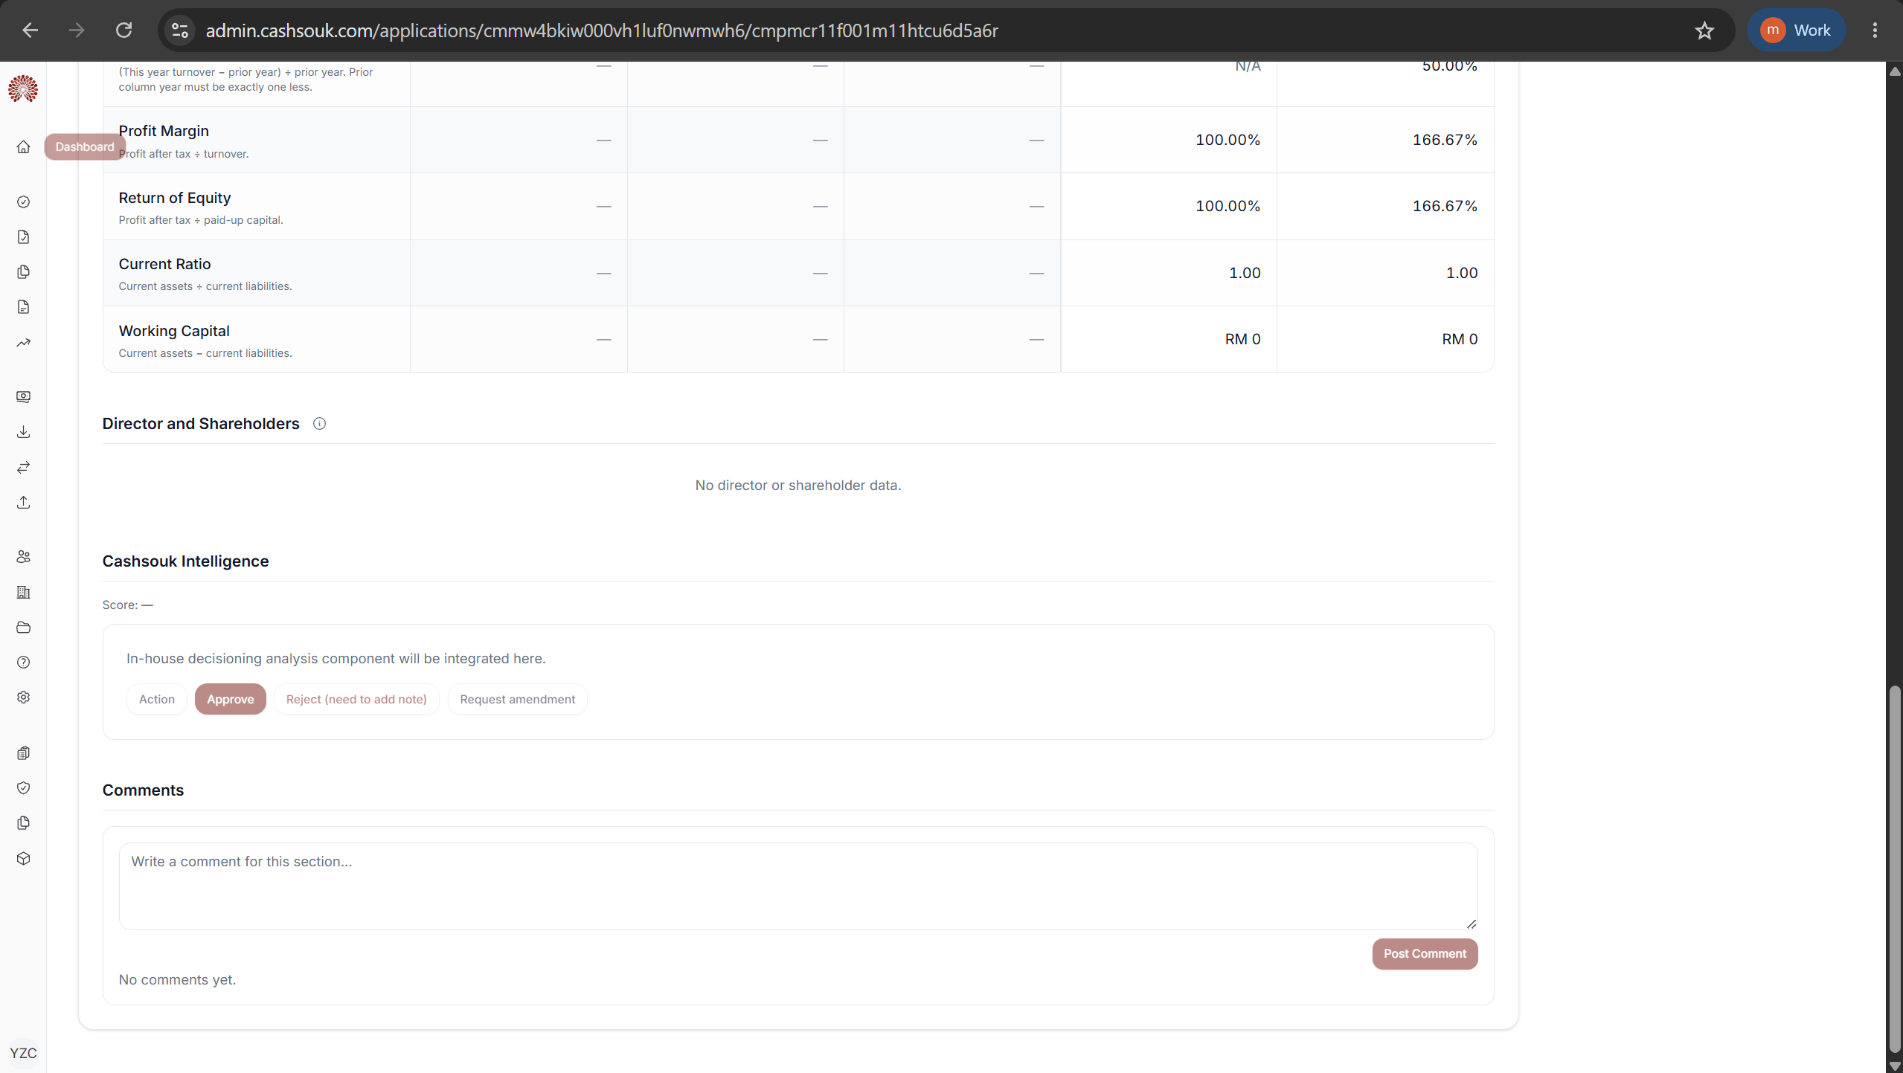
applications.view

Slide 13
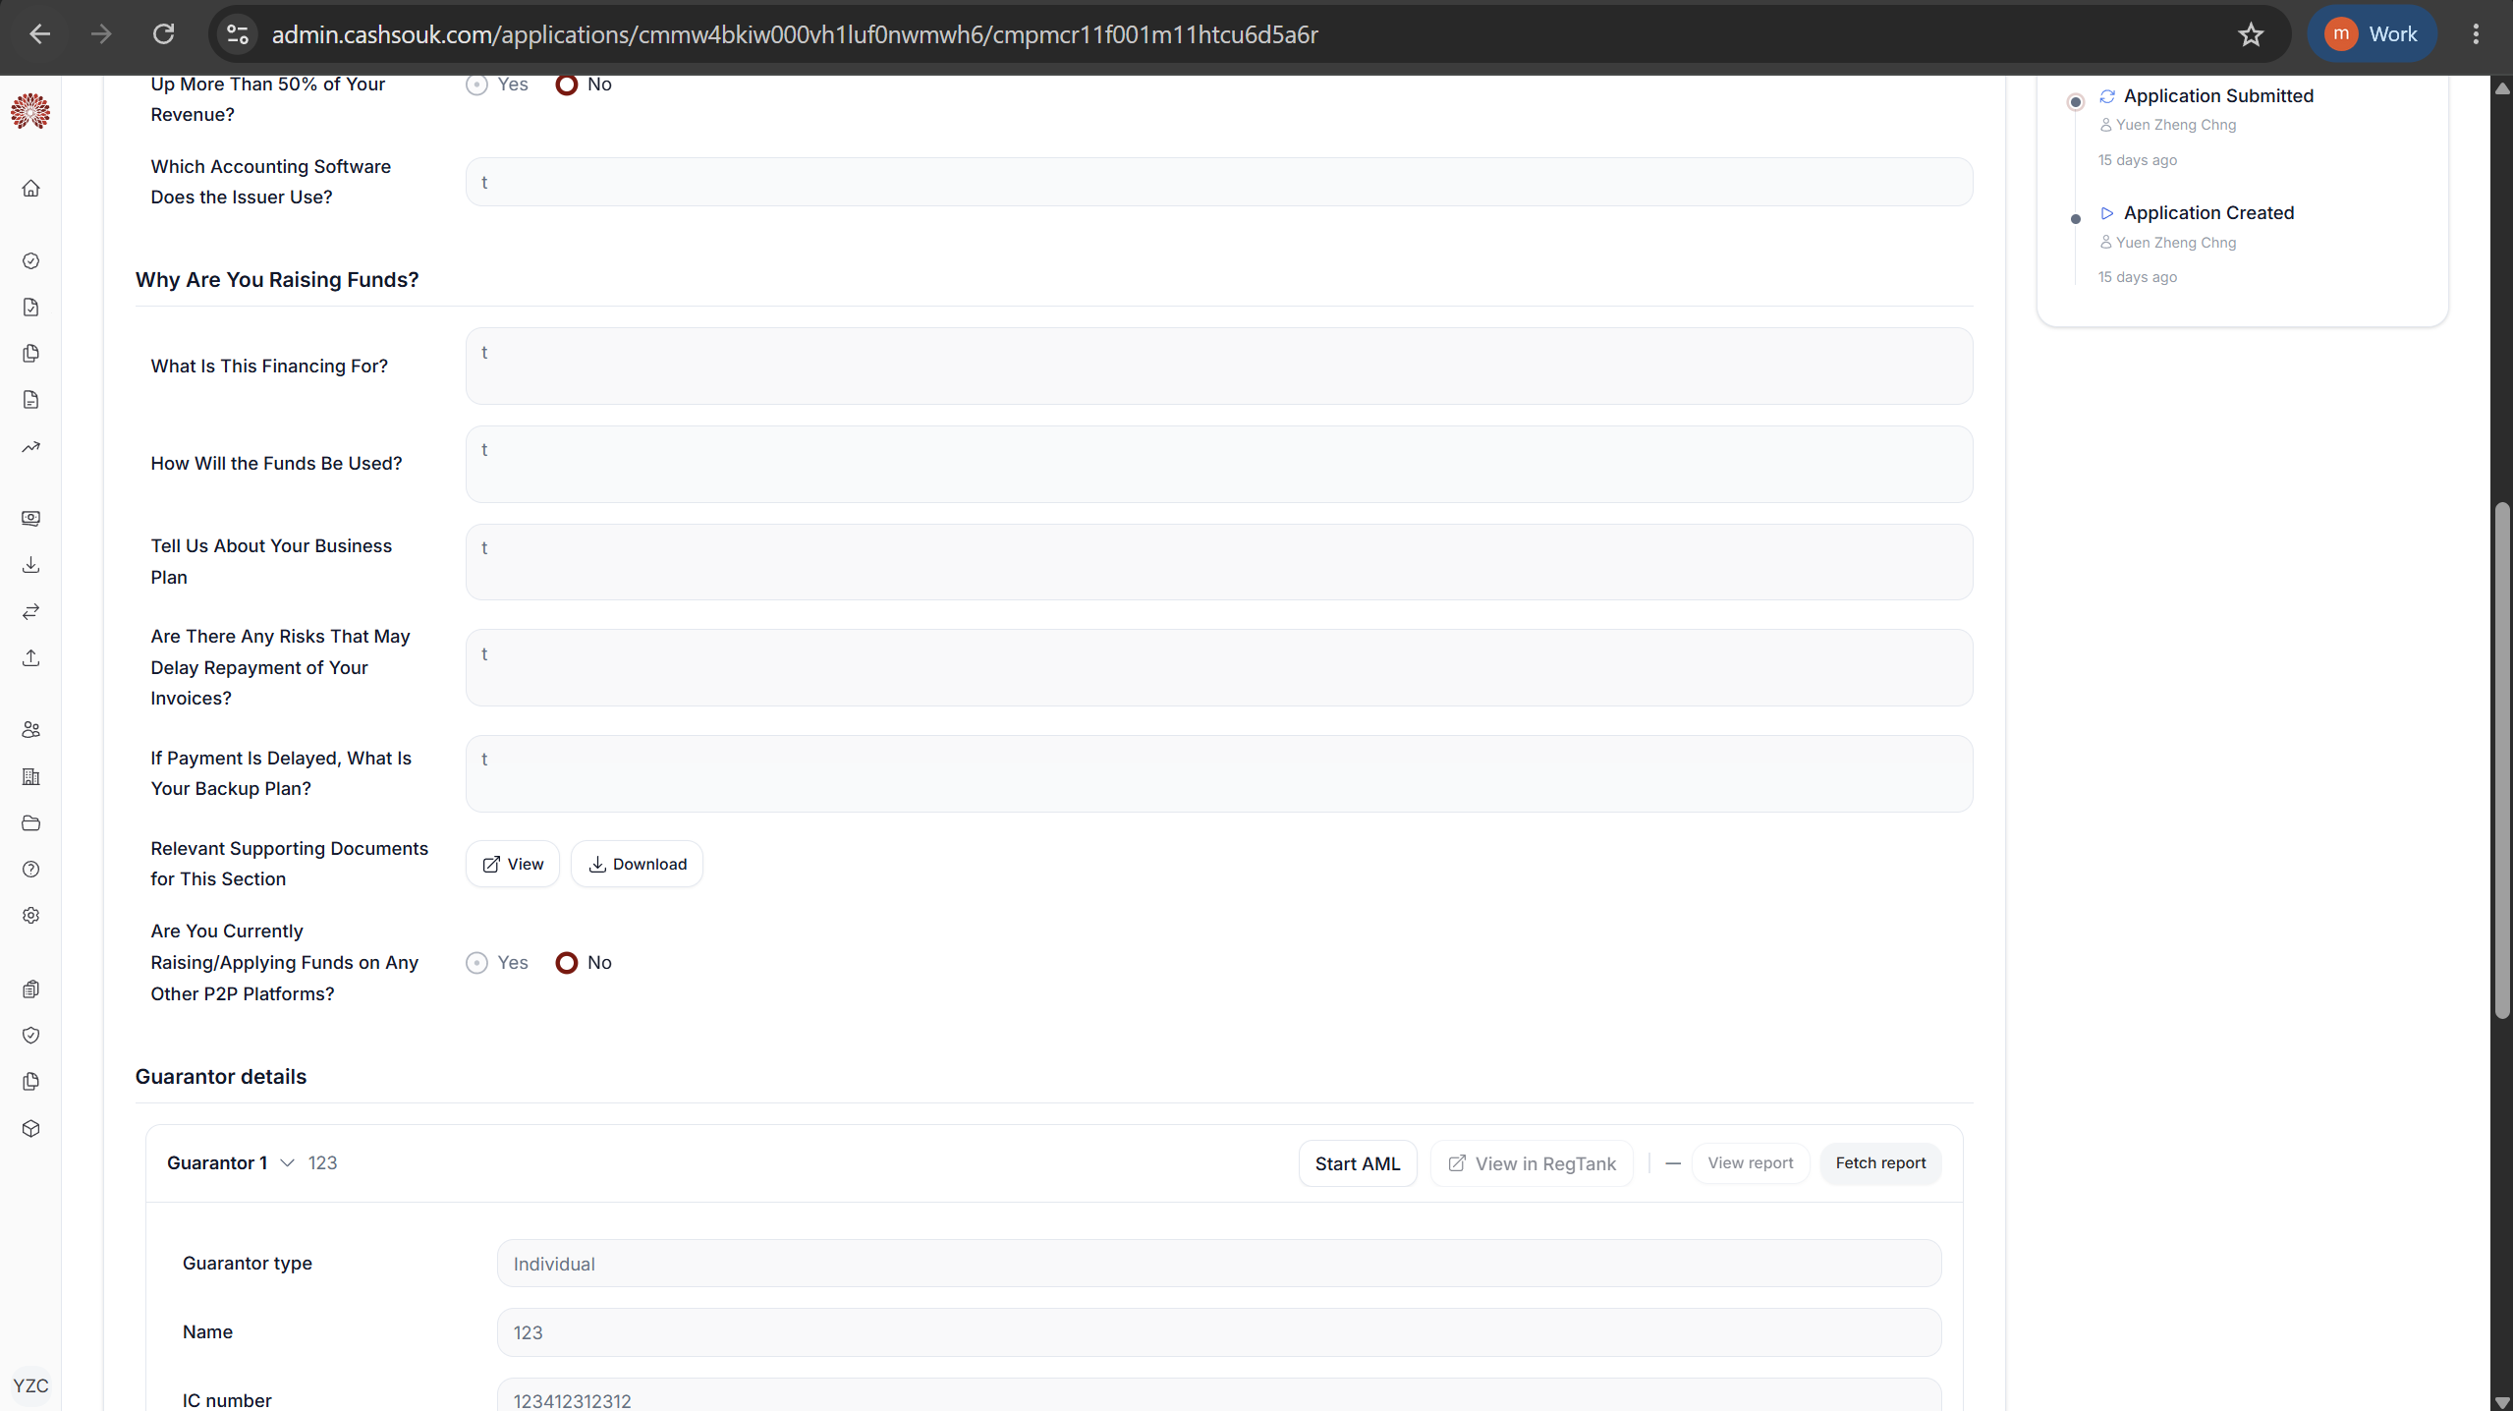
applications.view
applications.business_guarantor.manage

Slide 14
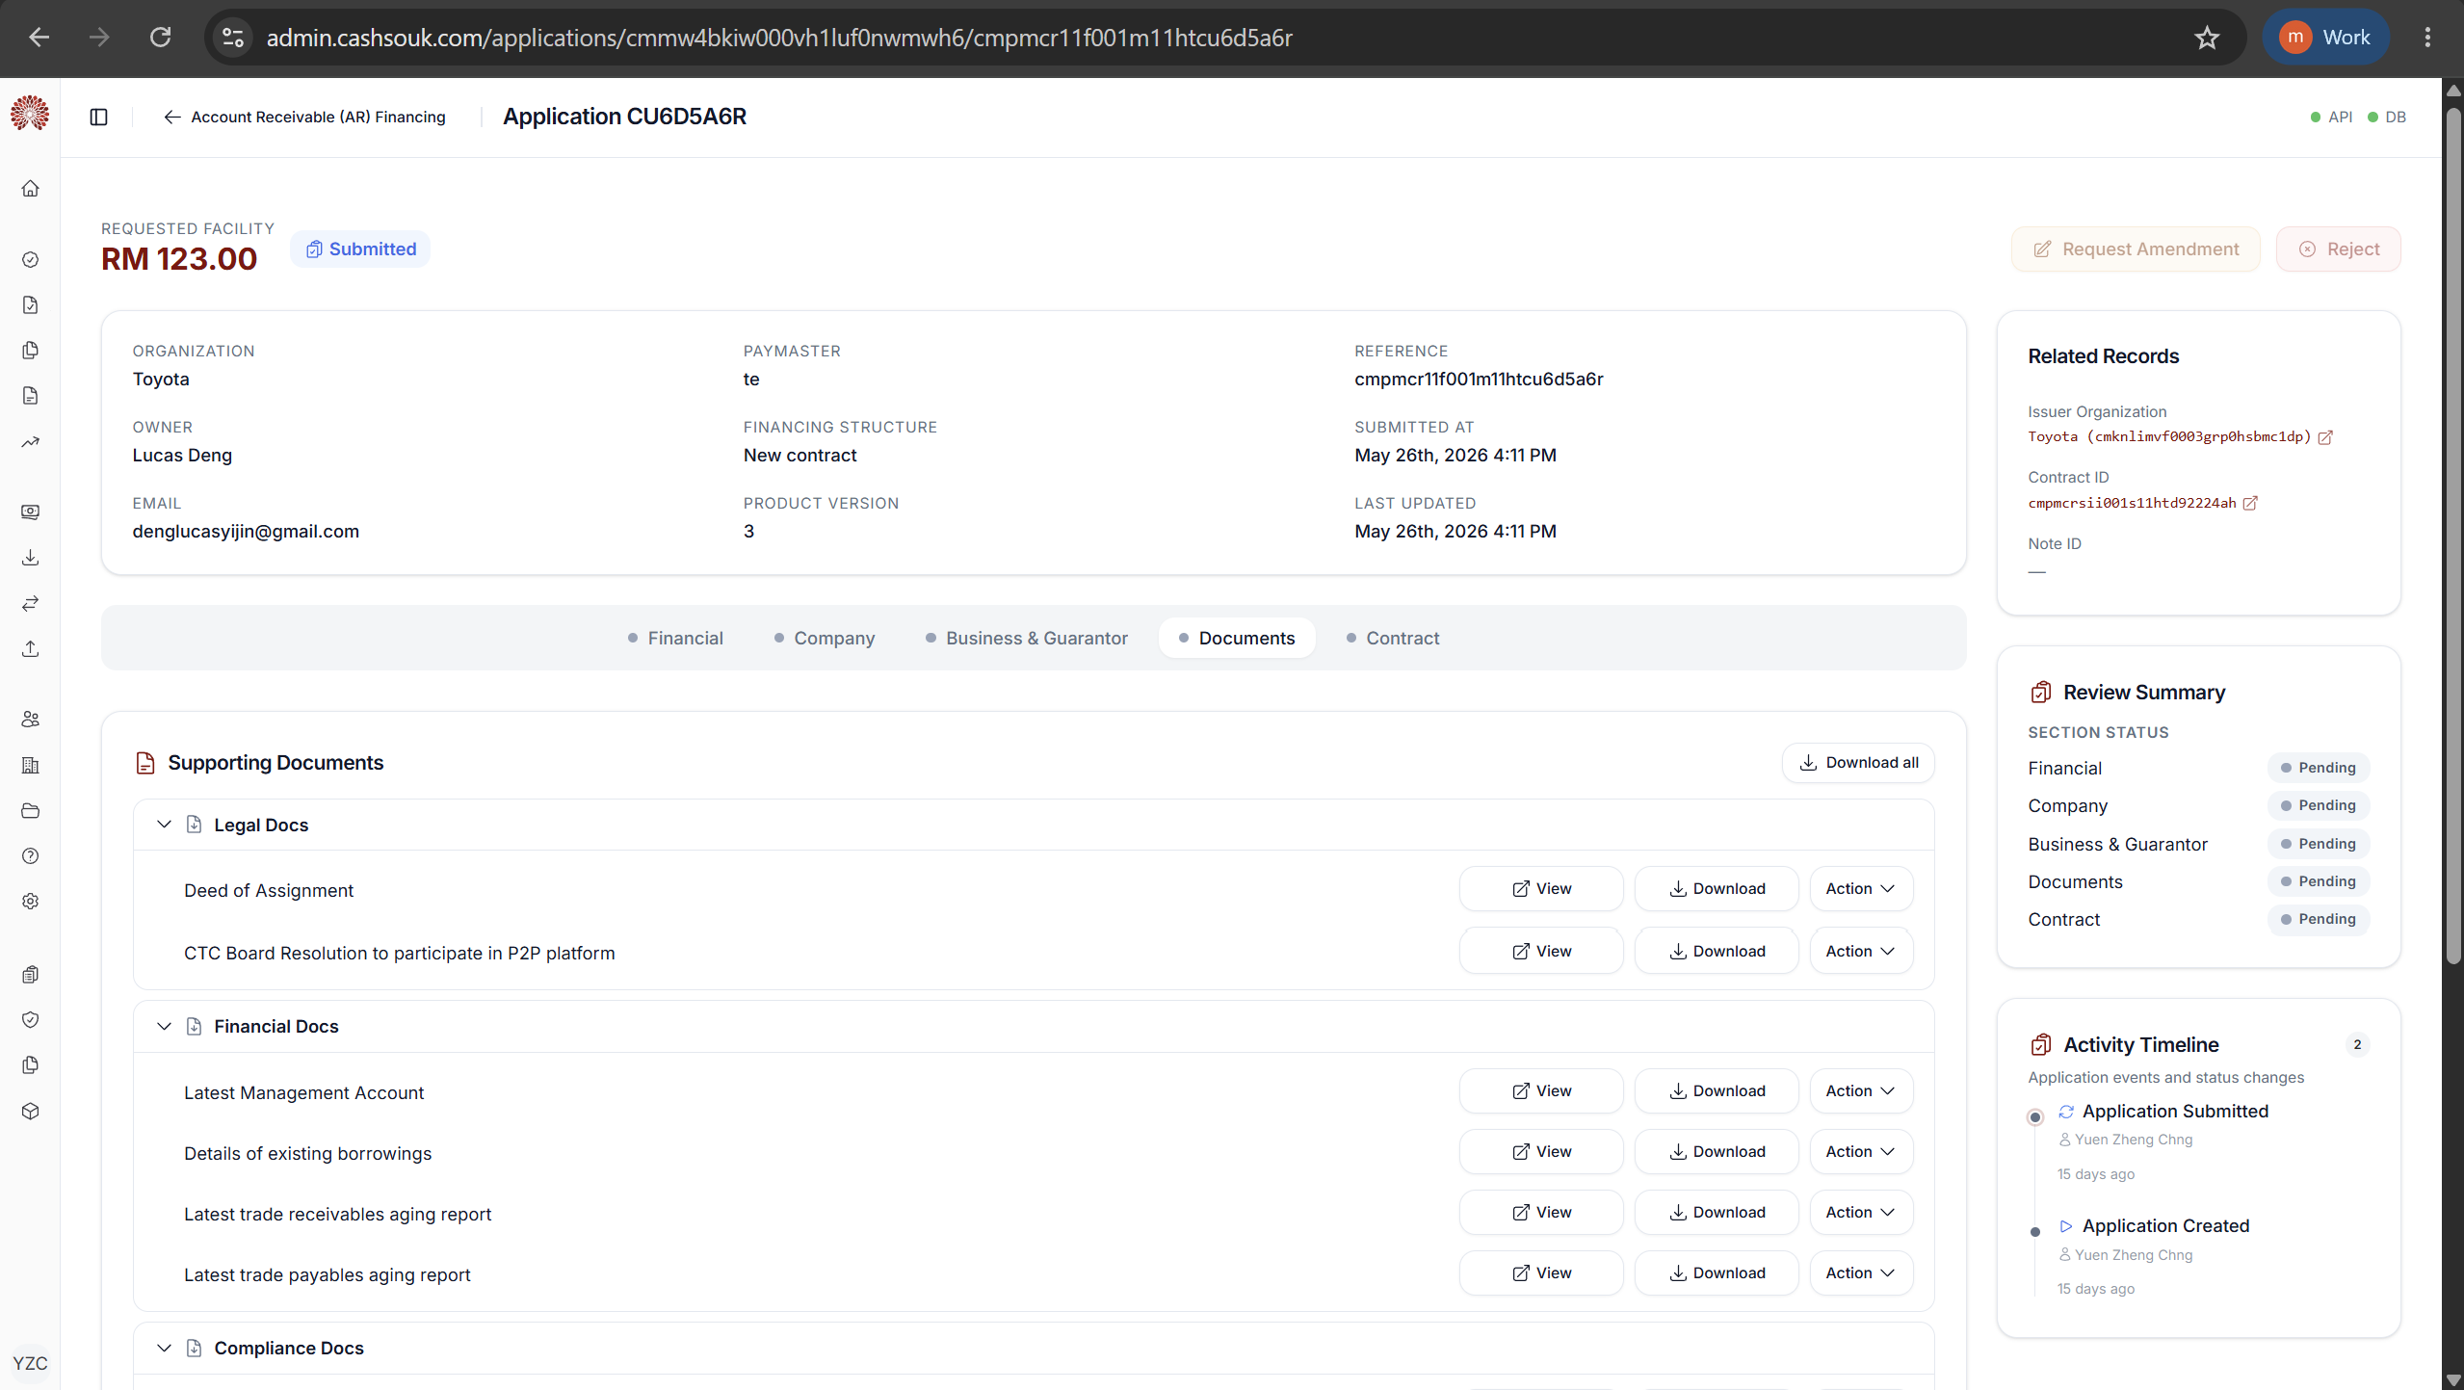
applications.view
applications.manage
applications.documents.manage

Slide 15
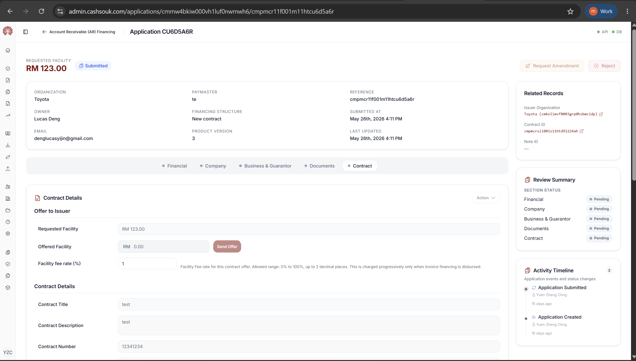
applications.view
applications.manage
applications.contract.manage

Slide 16
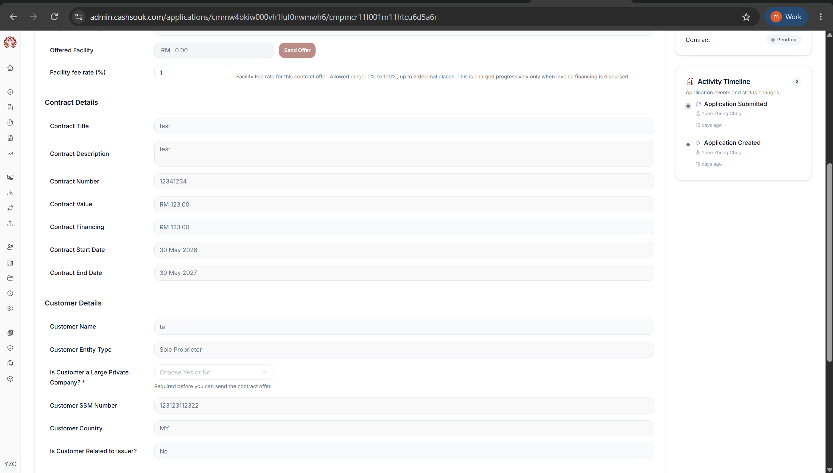
applications.view
applications.contract.manage

Slide 17
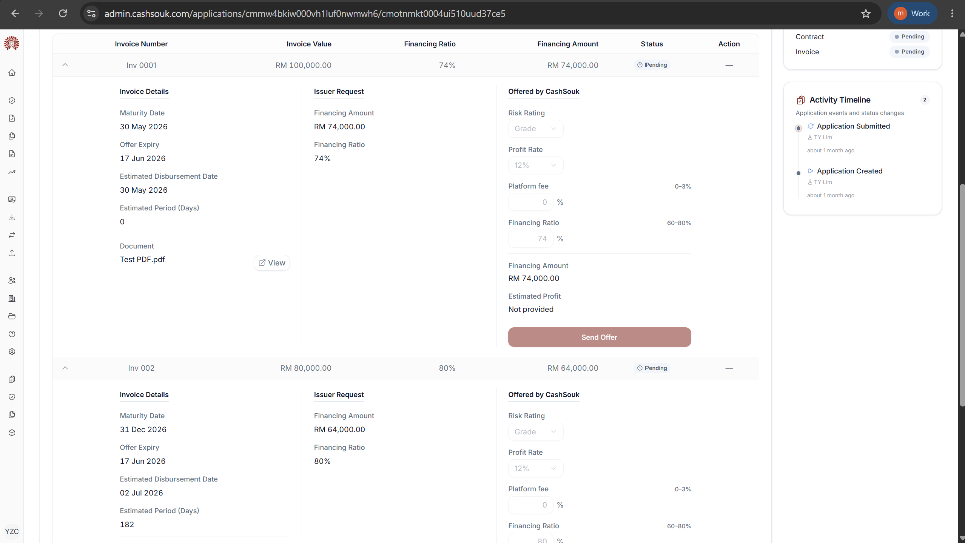
applications.view
applications.invoice.manage

Slide 18
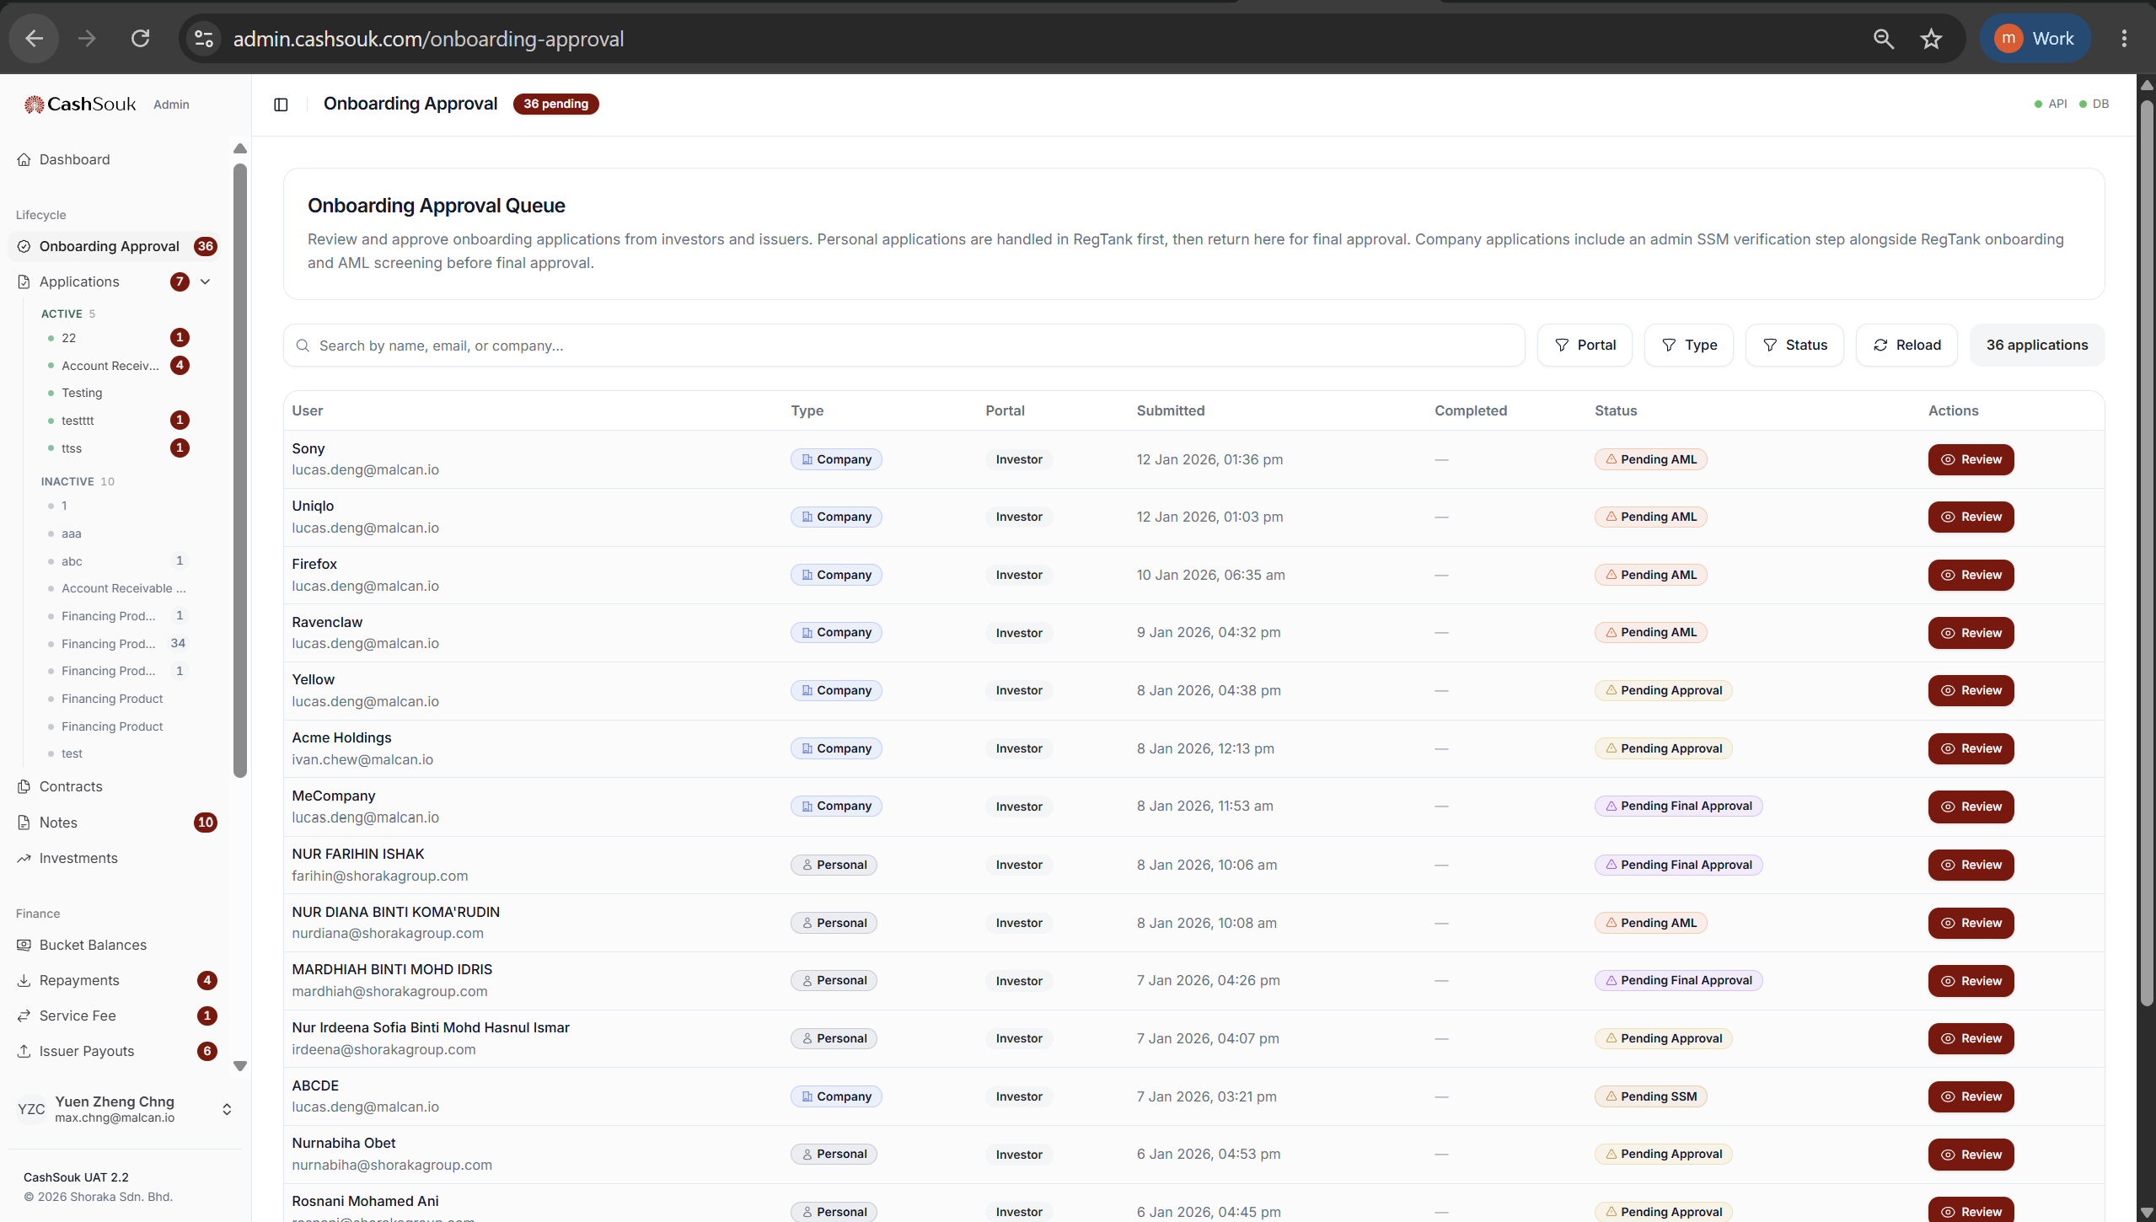
onboarding.view
onboarding.manage

Slide 19
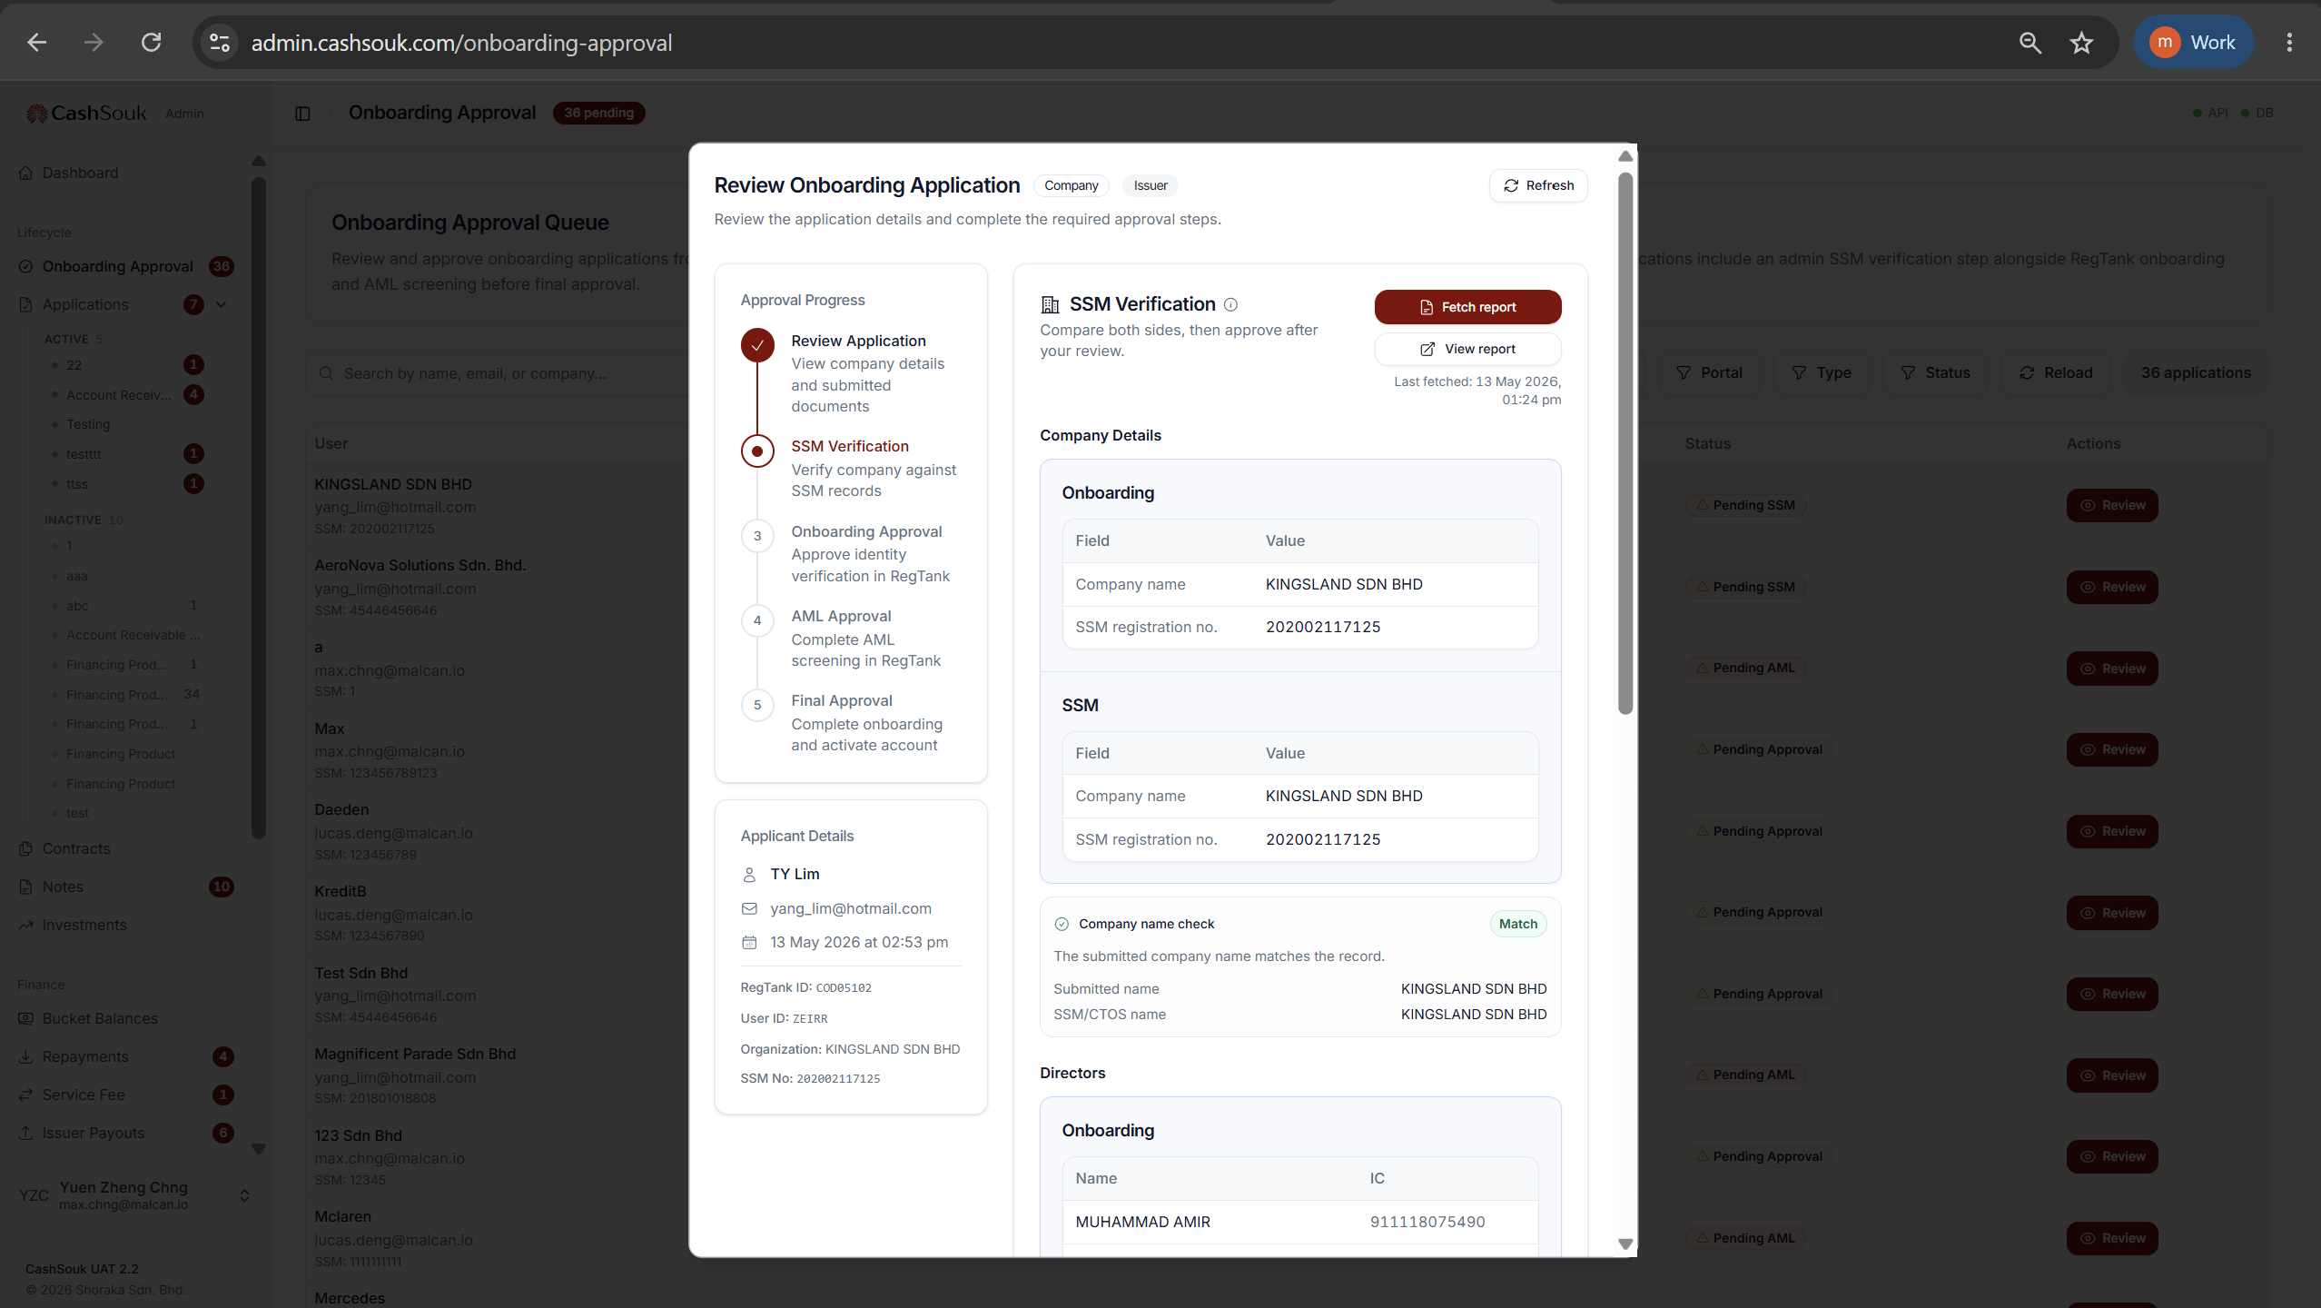
onboarding.view
onboarding.manage

Slide 20
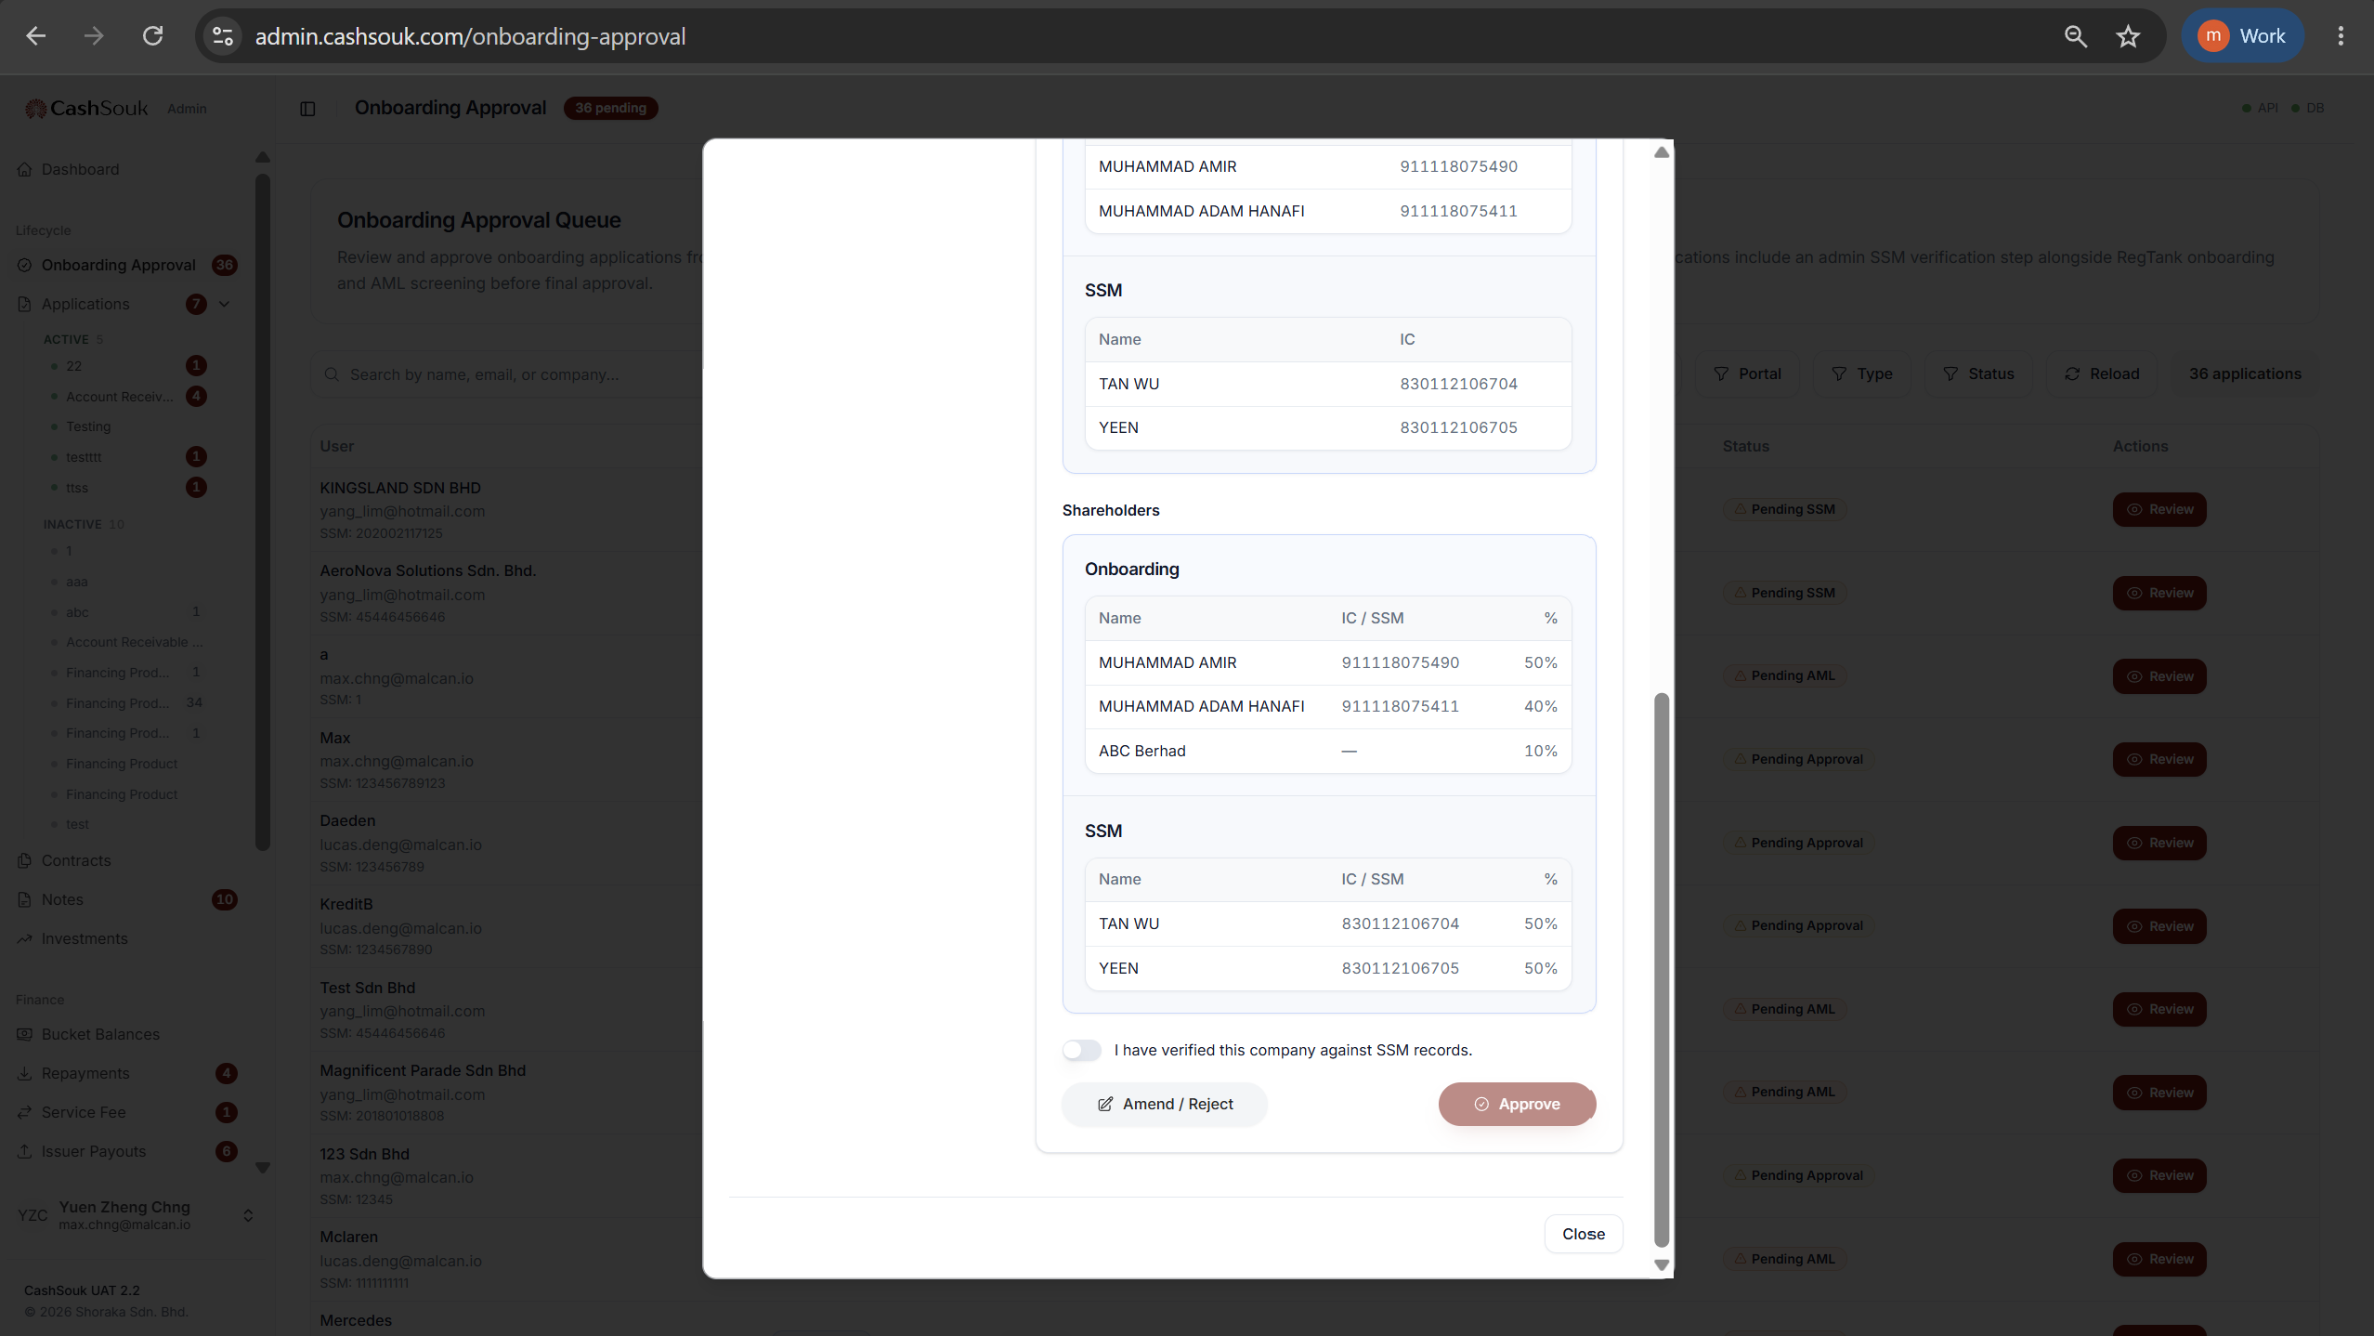
onboarding.view
onboarding.manage

Slide 21
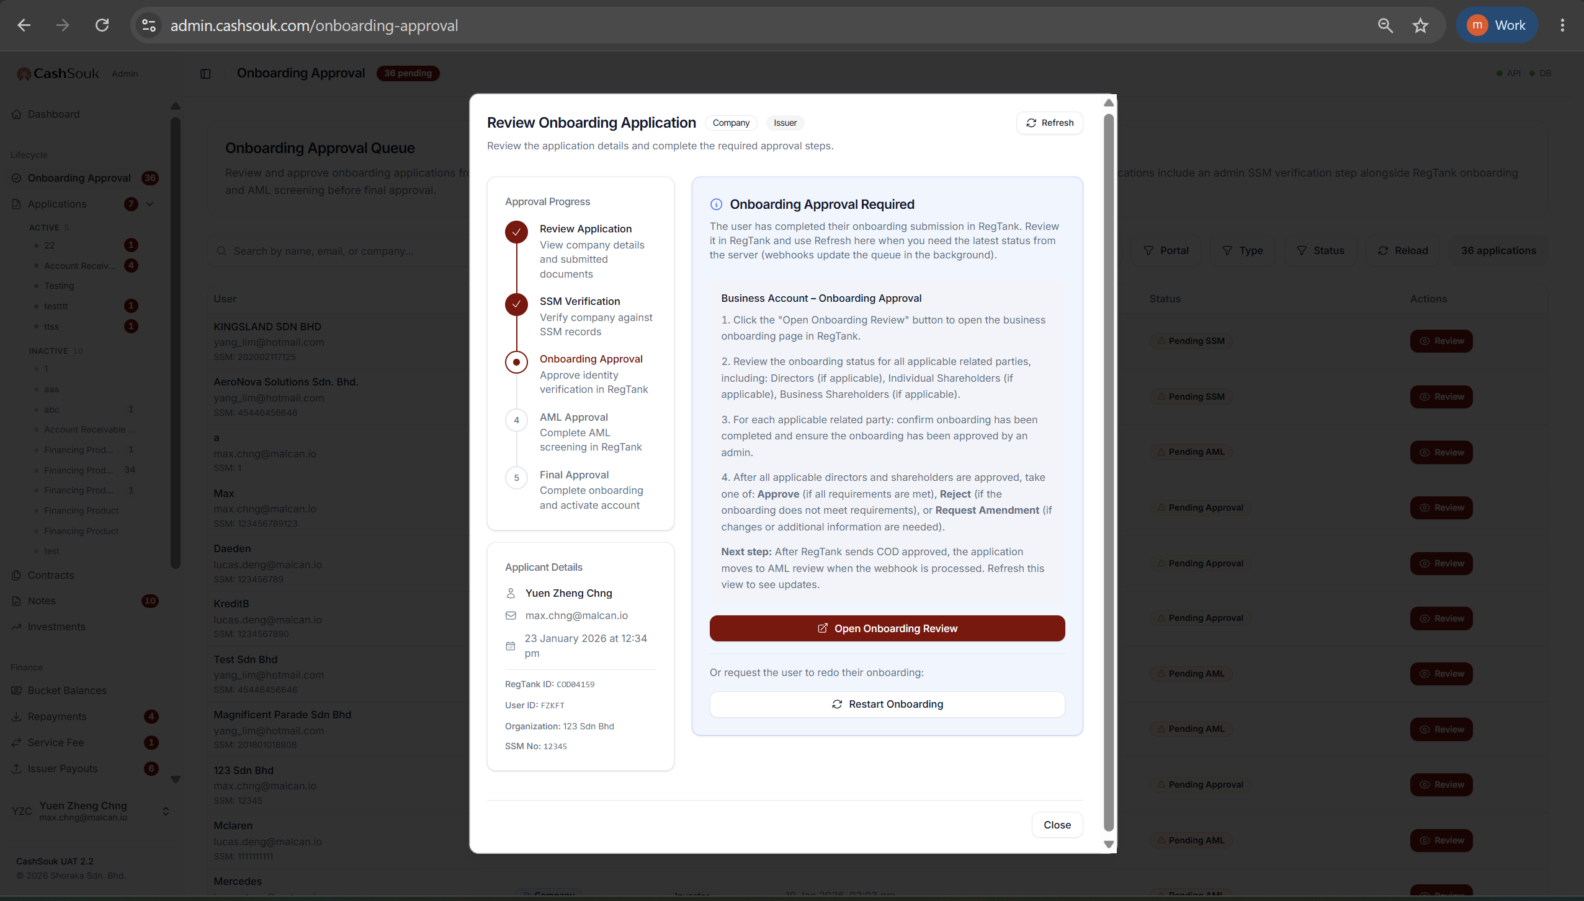
onboarding.view
onboarding.manage

Slide 22
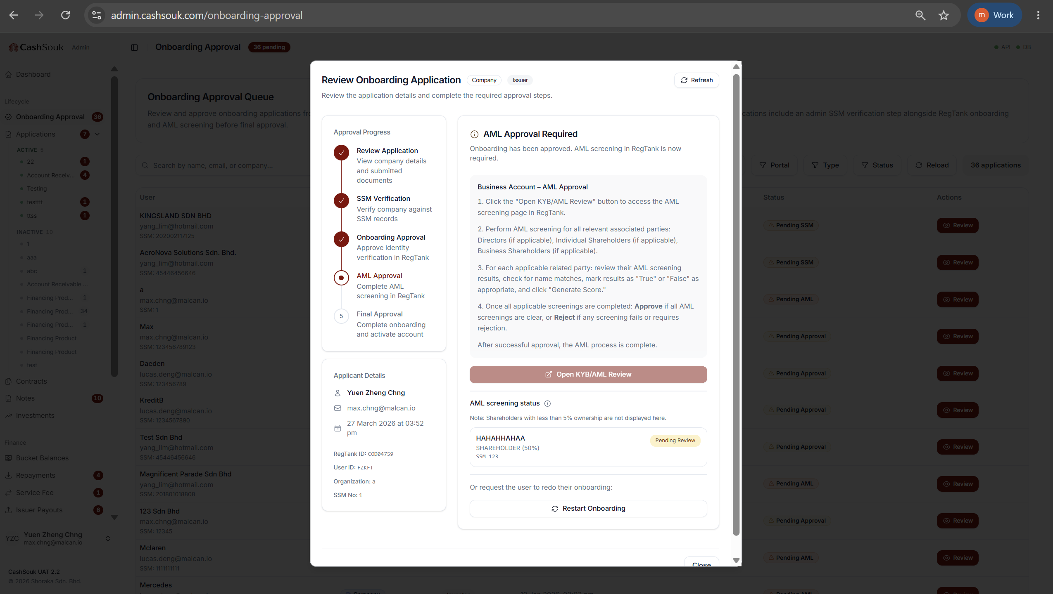
onboarding.view
onboarding.manage

Slide 23
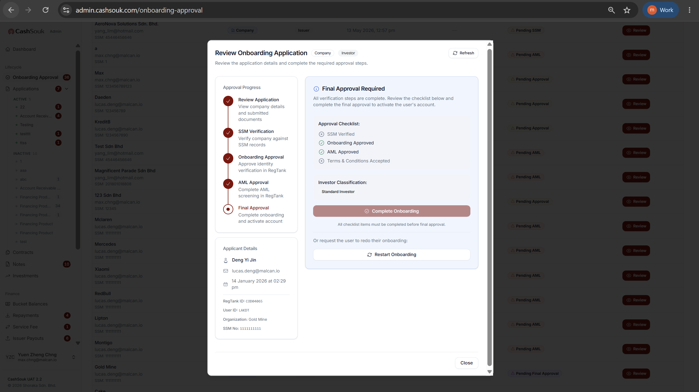
onboarding.view
onboarding.manage

Slide 24
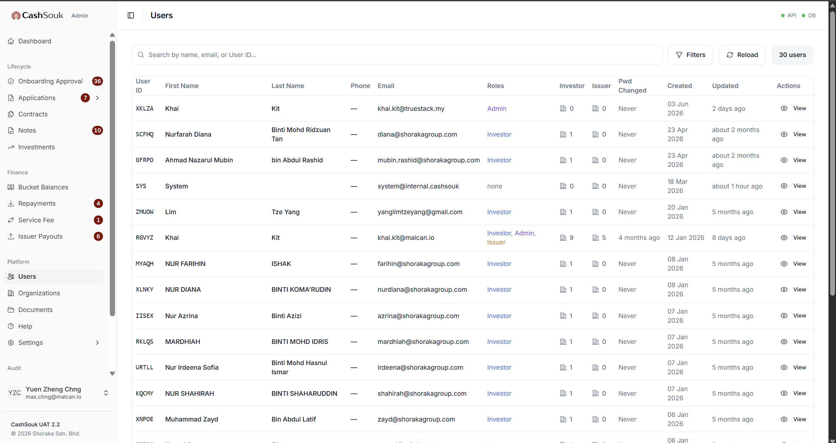
users.view

Slide 25
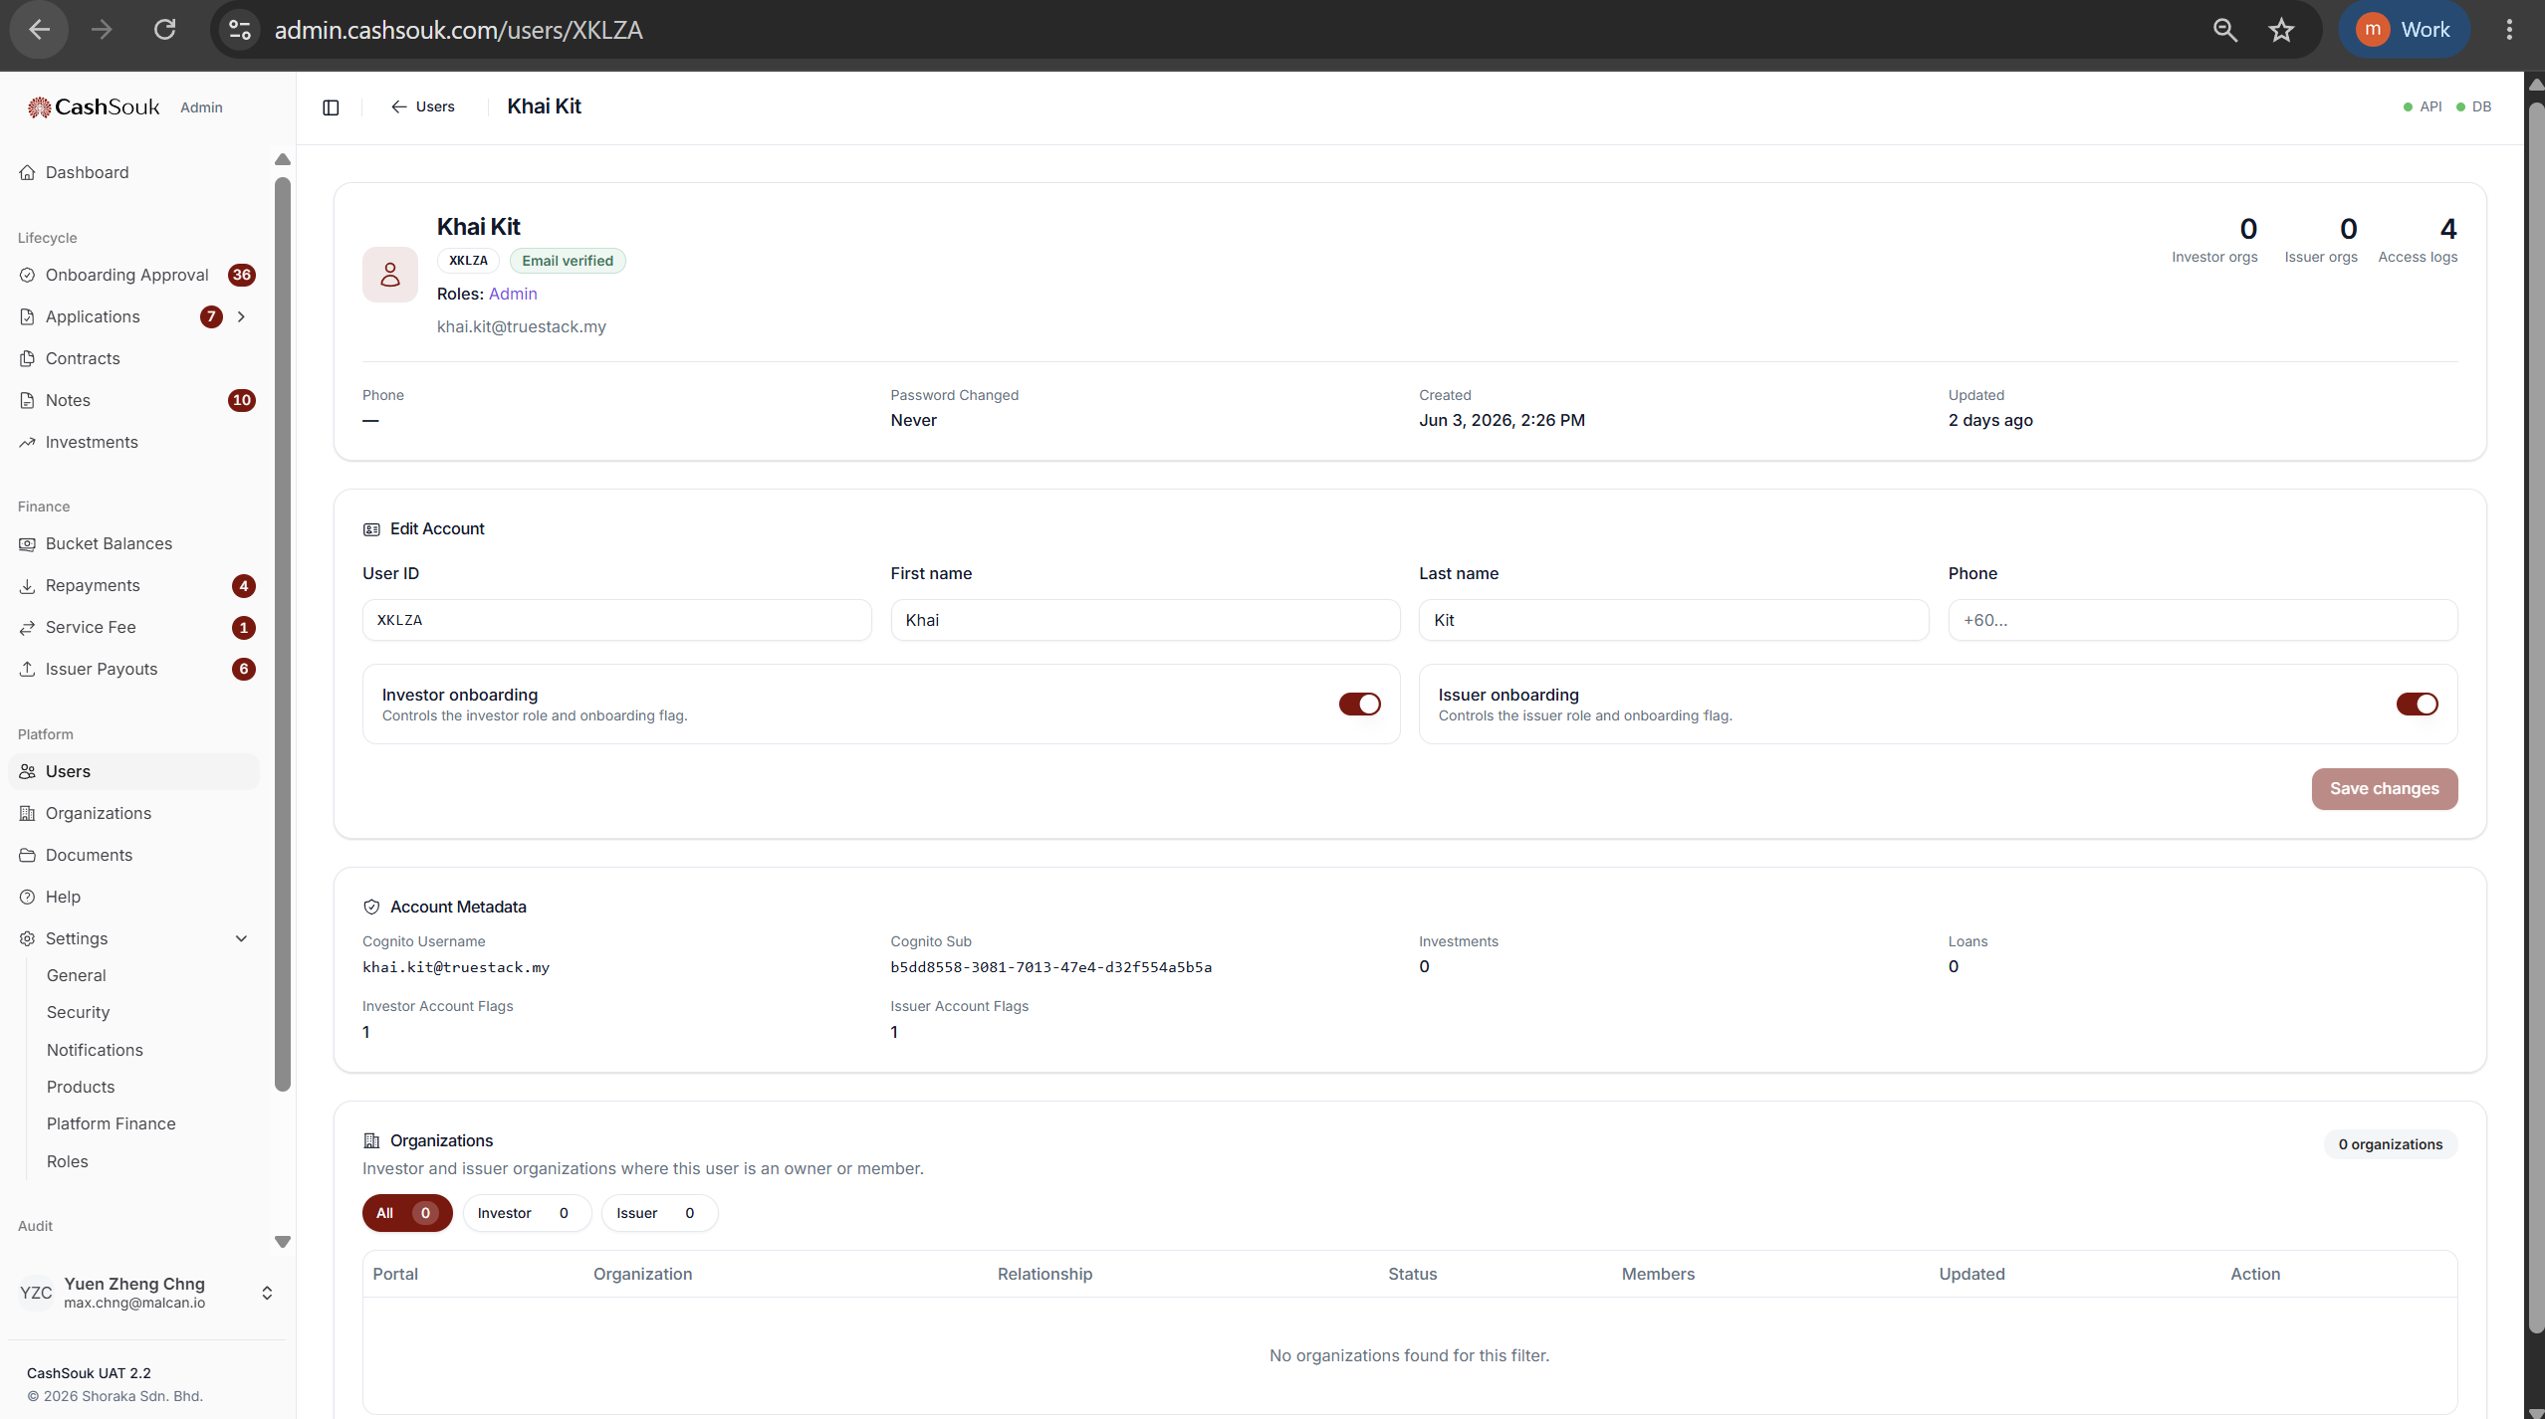
users.view
users.manage

Slide 26
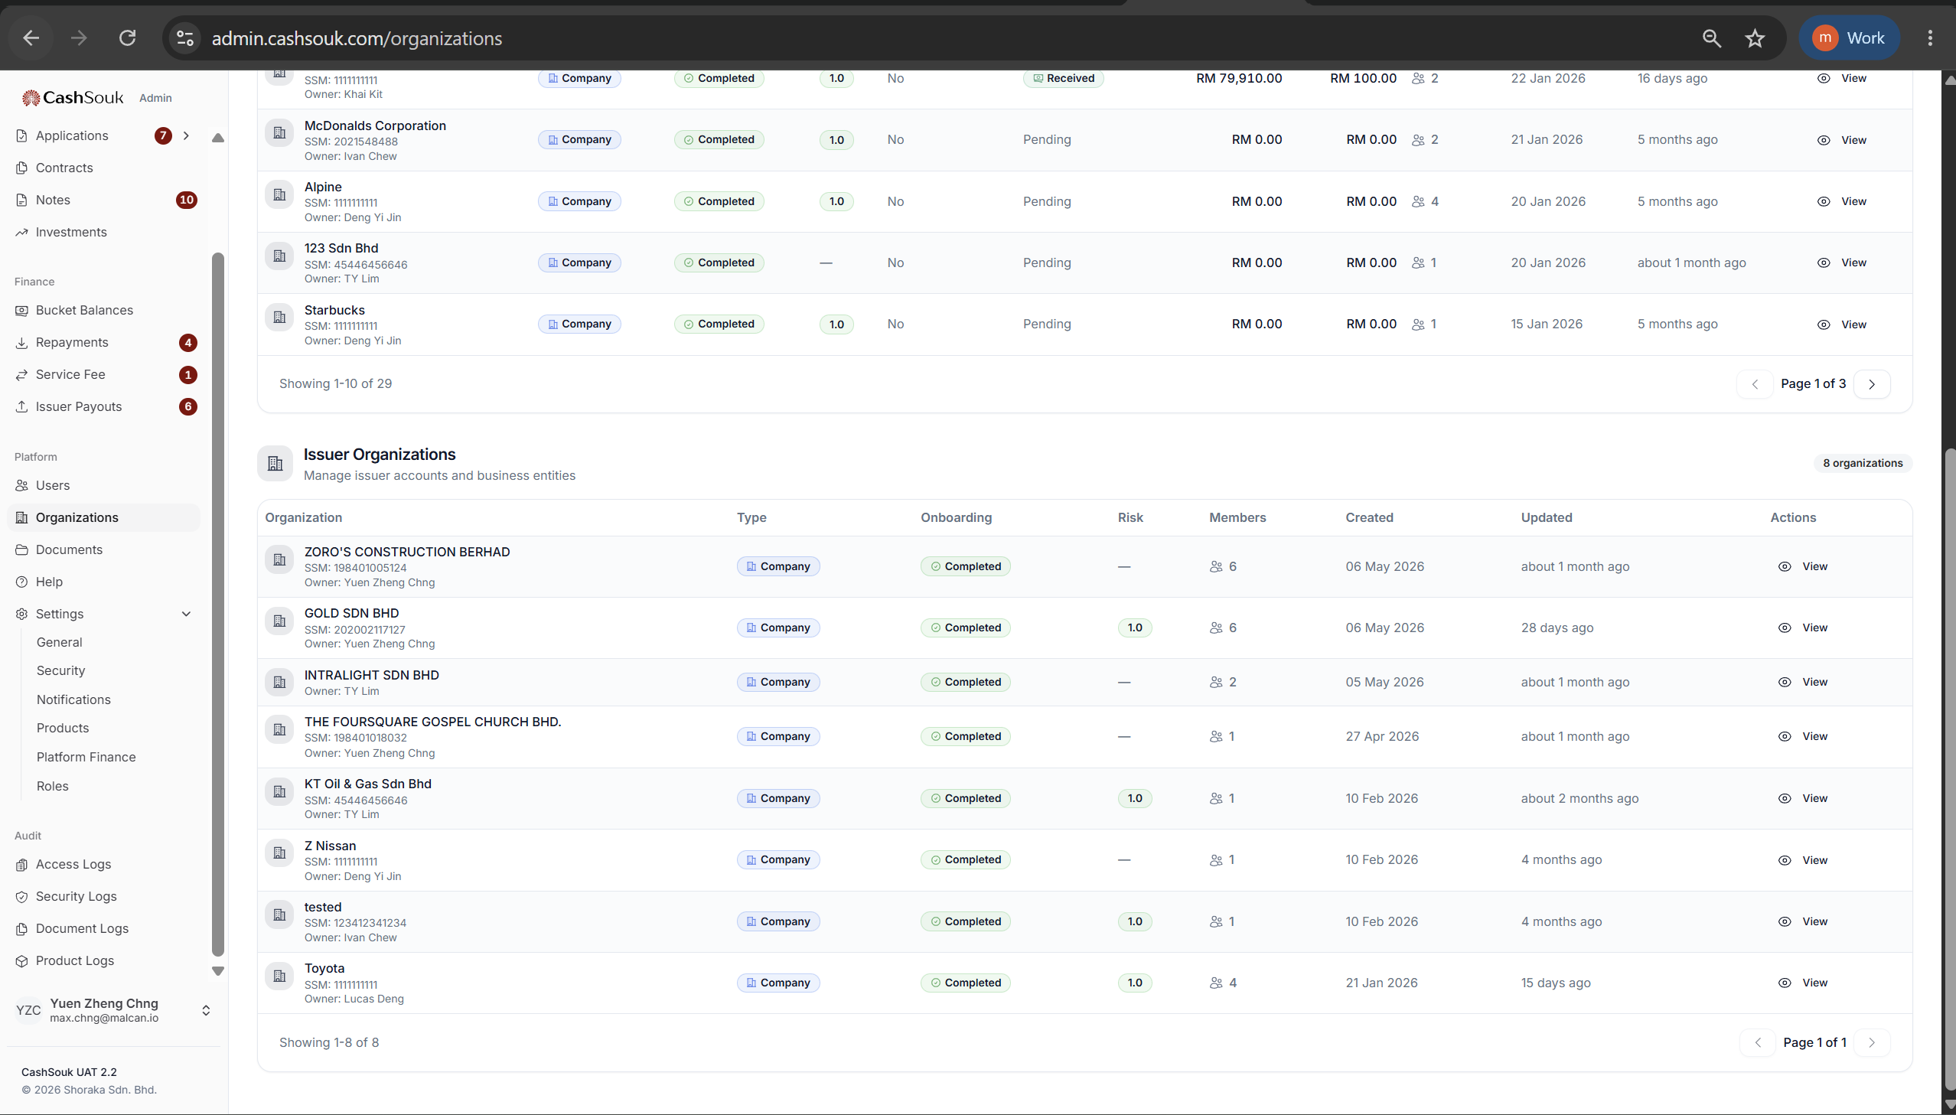
organizations.view

Slide 27
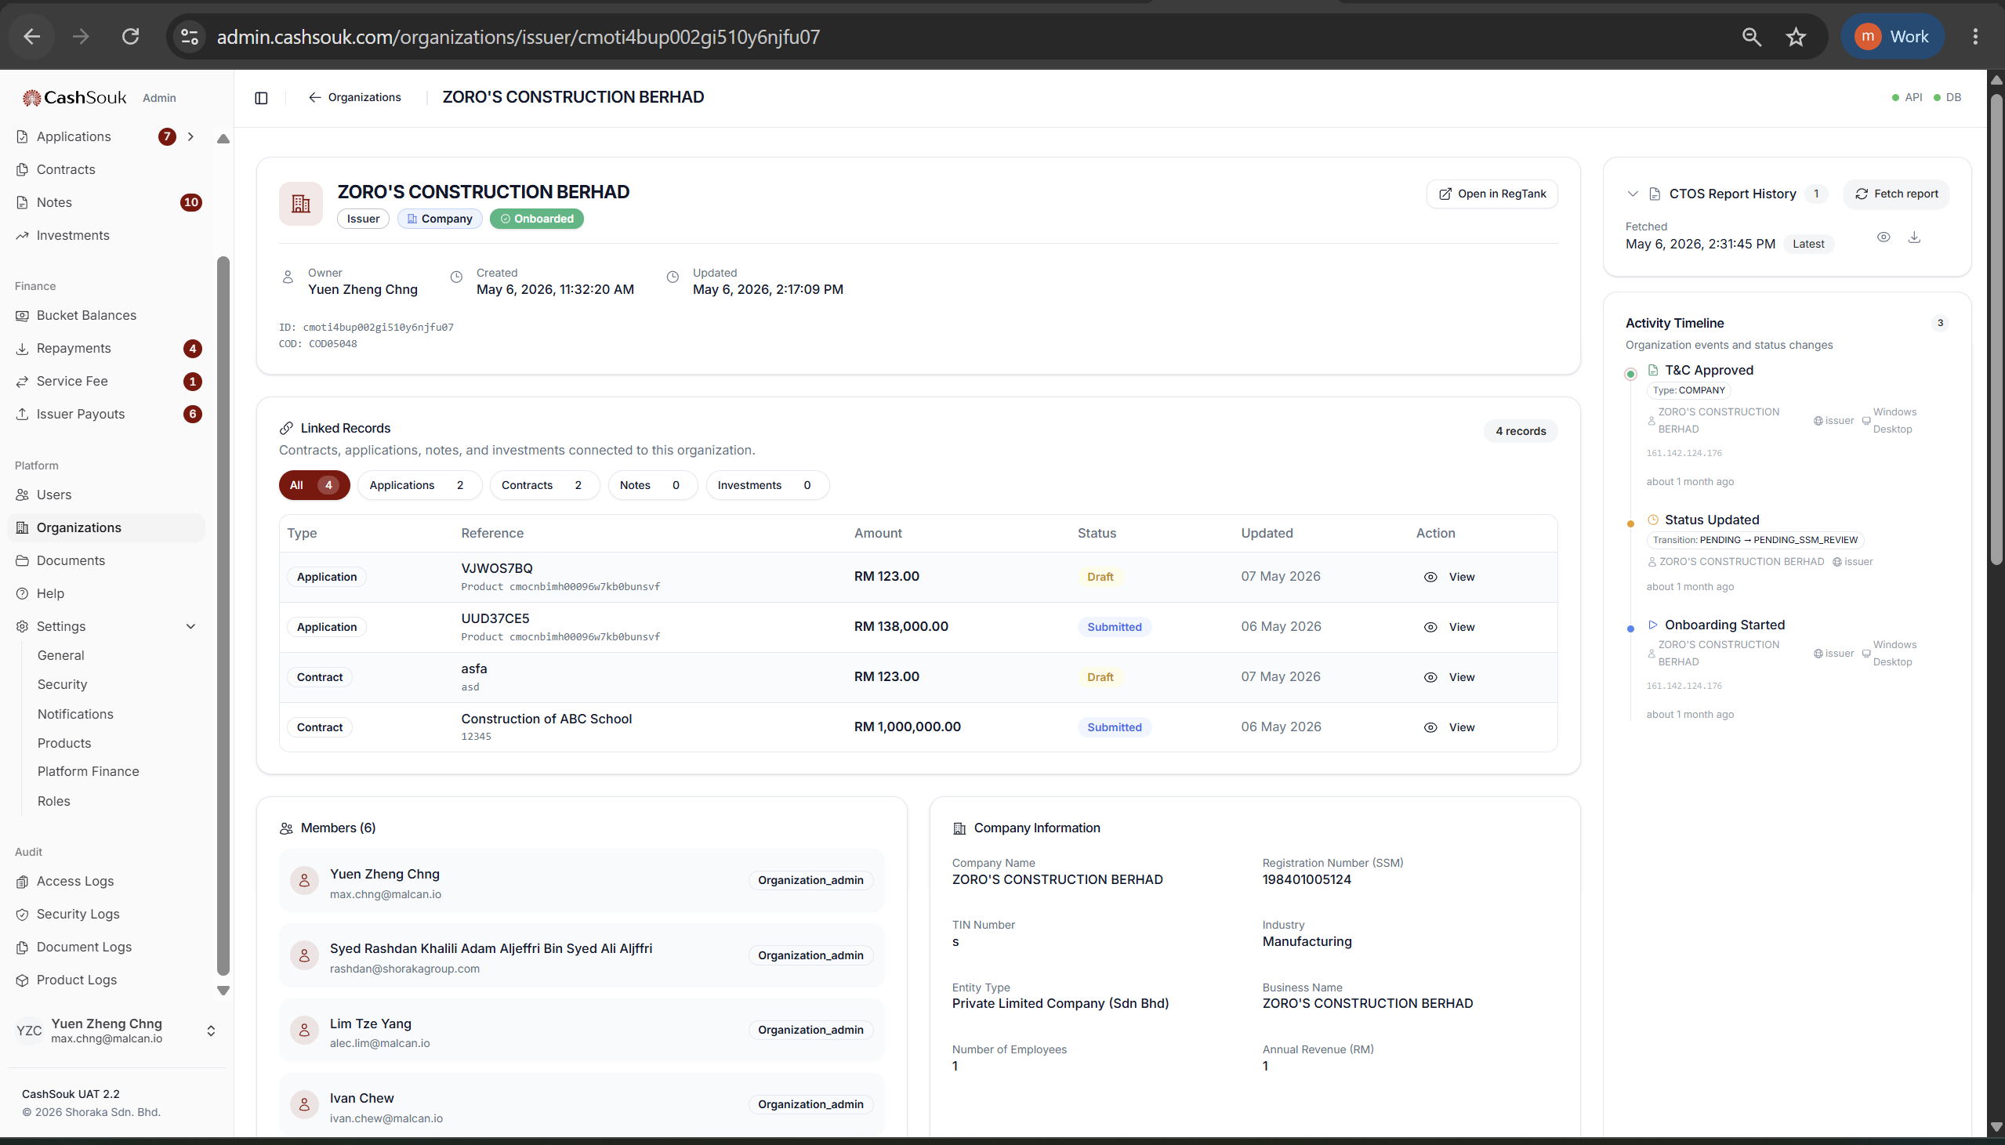
organizations.view
organizations.manage

Slide 28
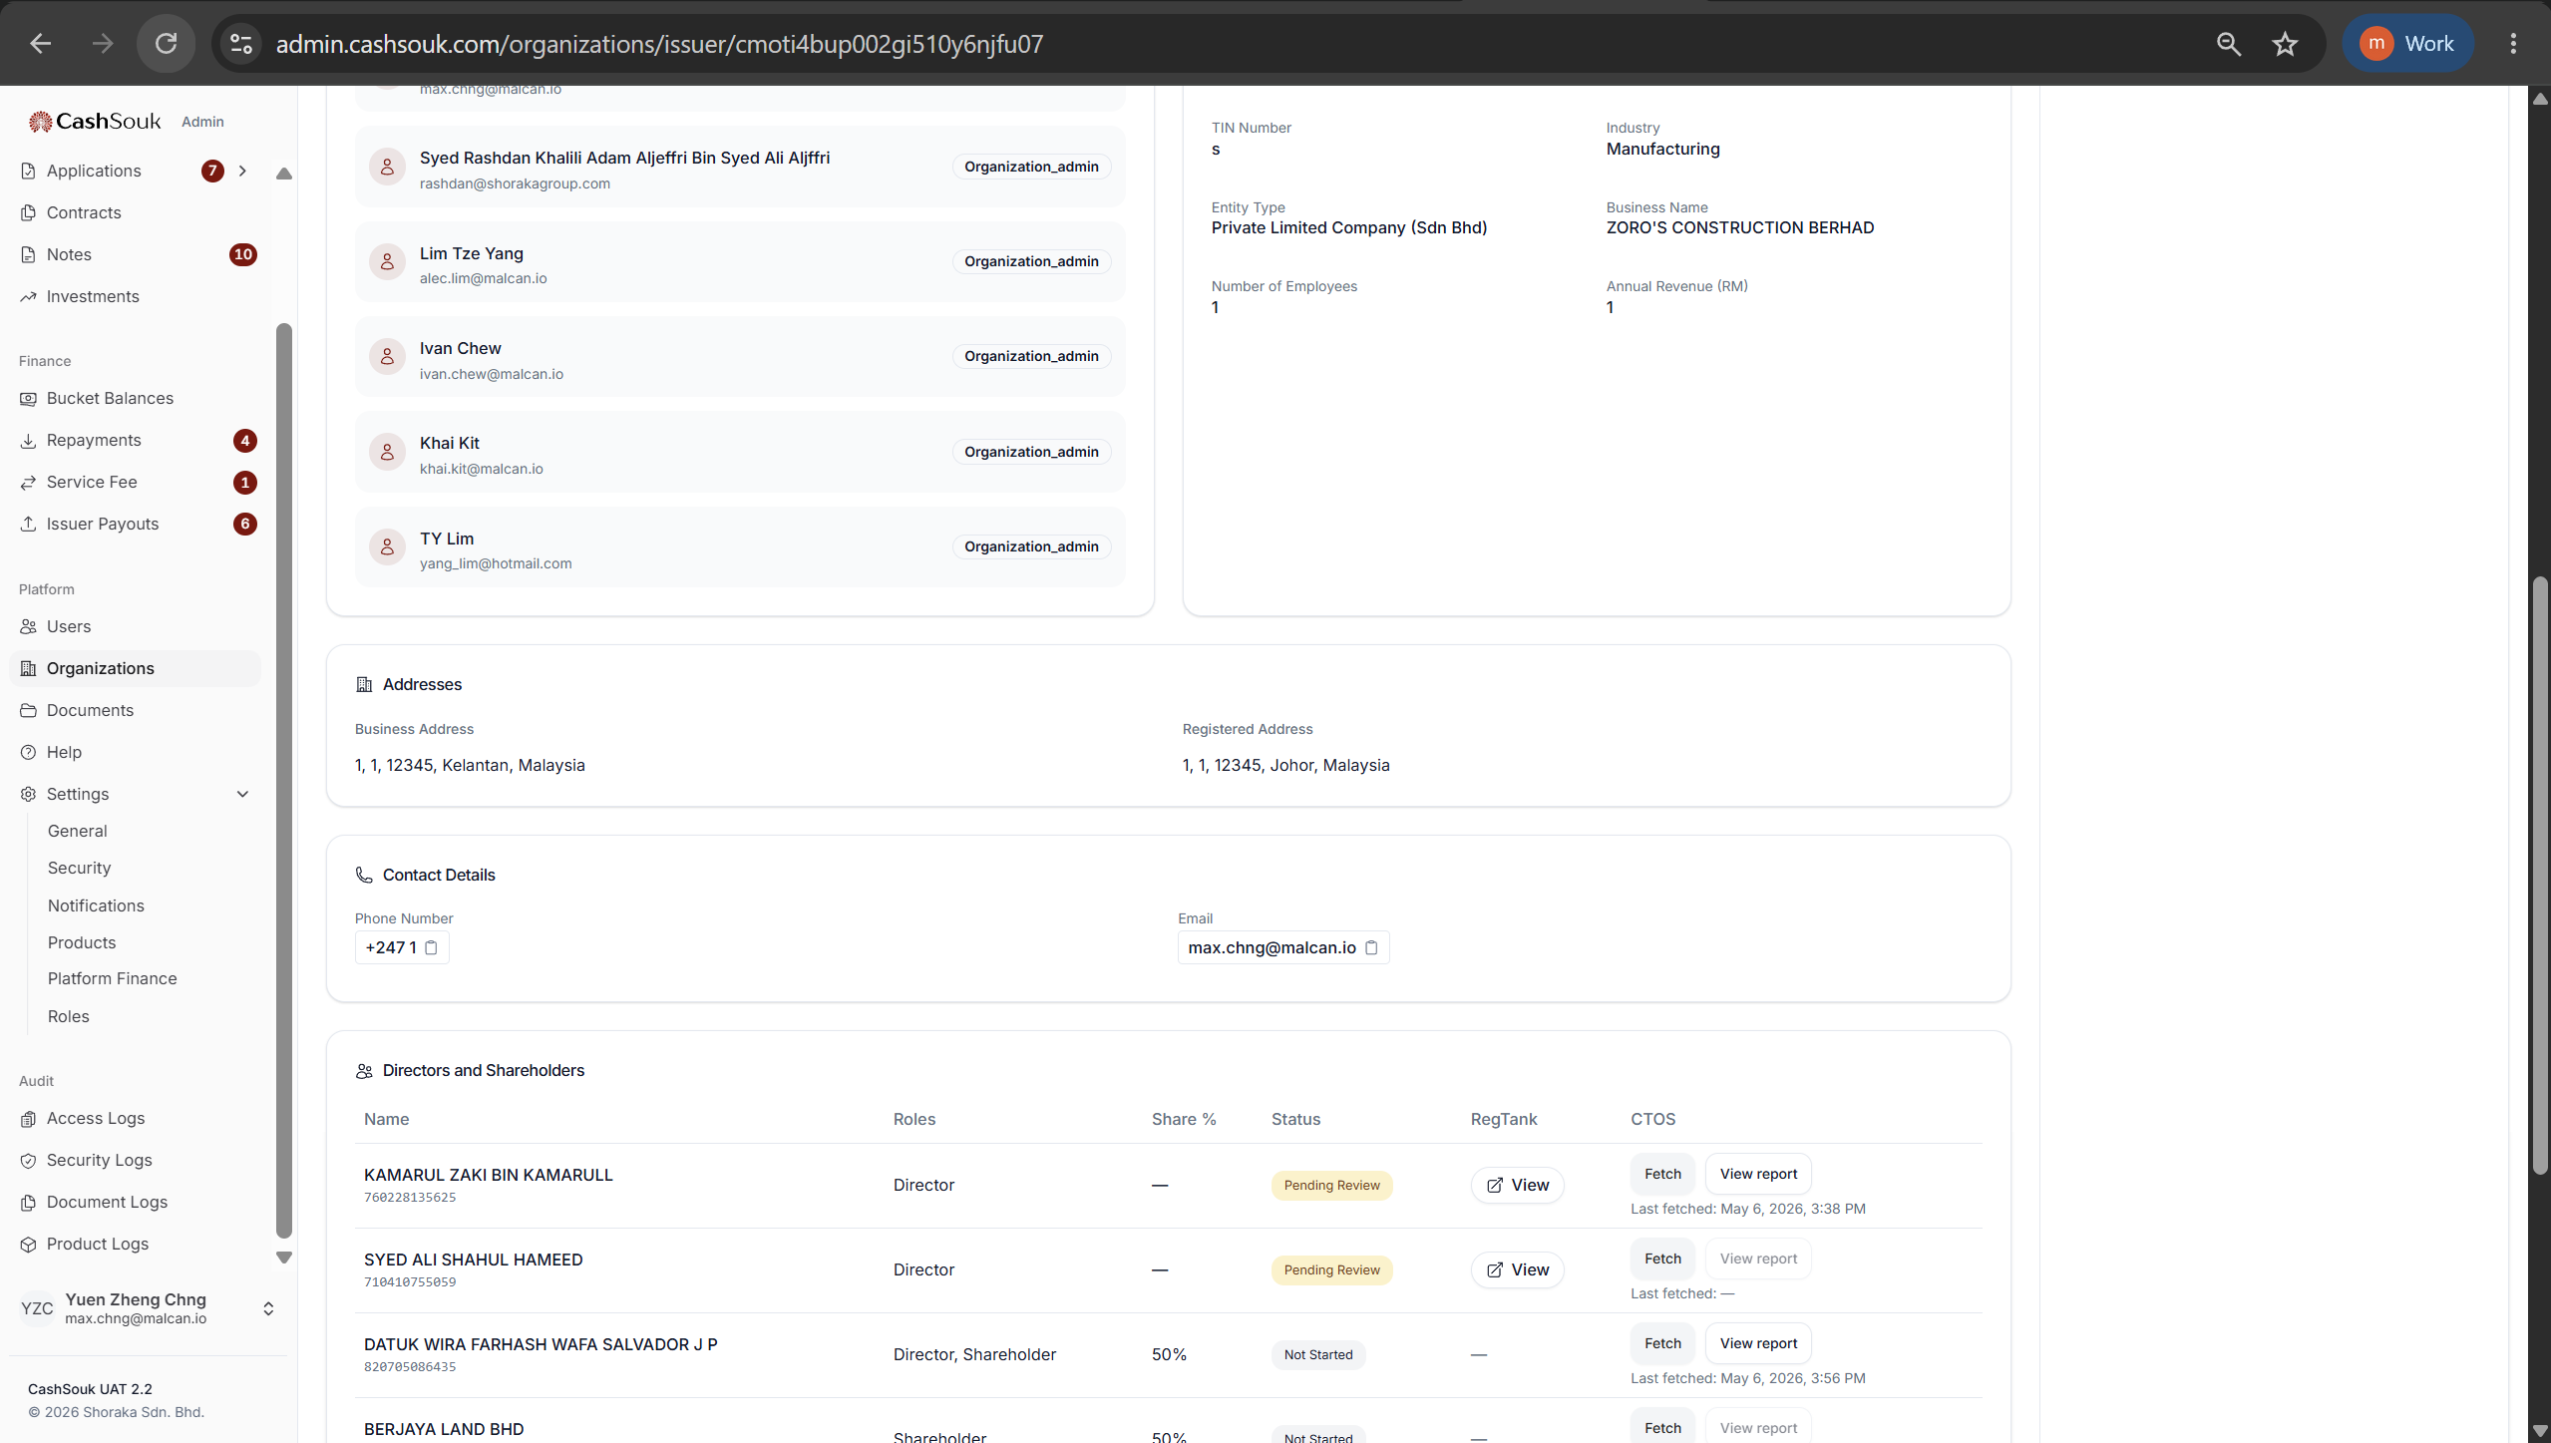

Slide 29
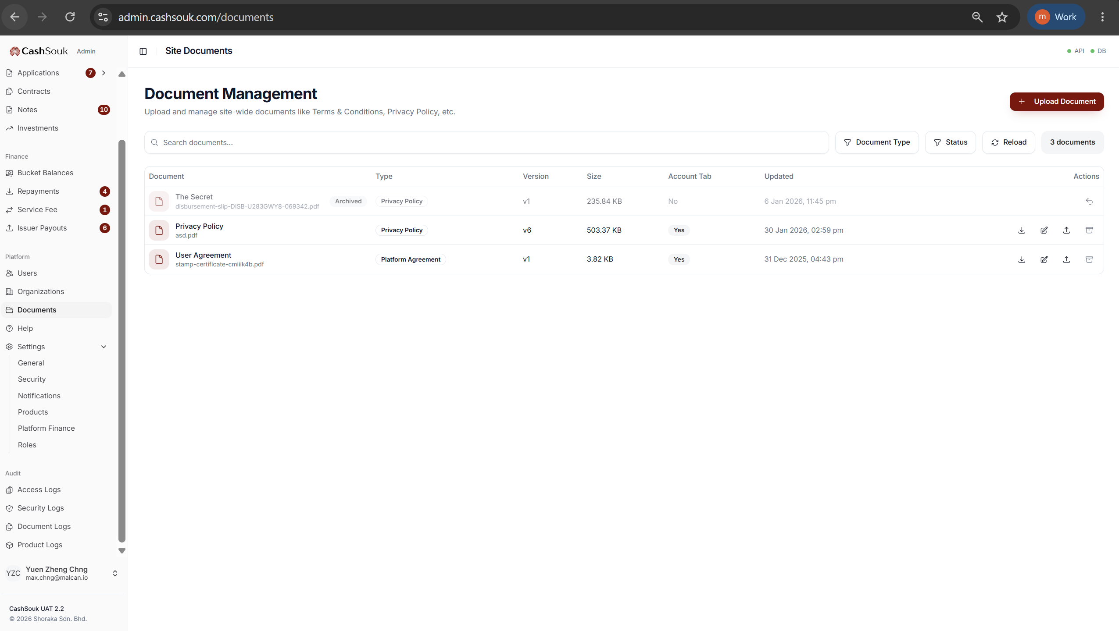
document_management.view
document_management.manage

Slide 30
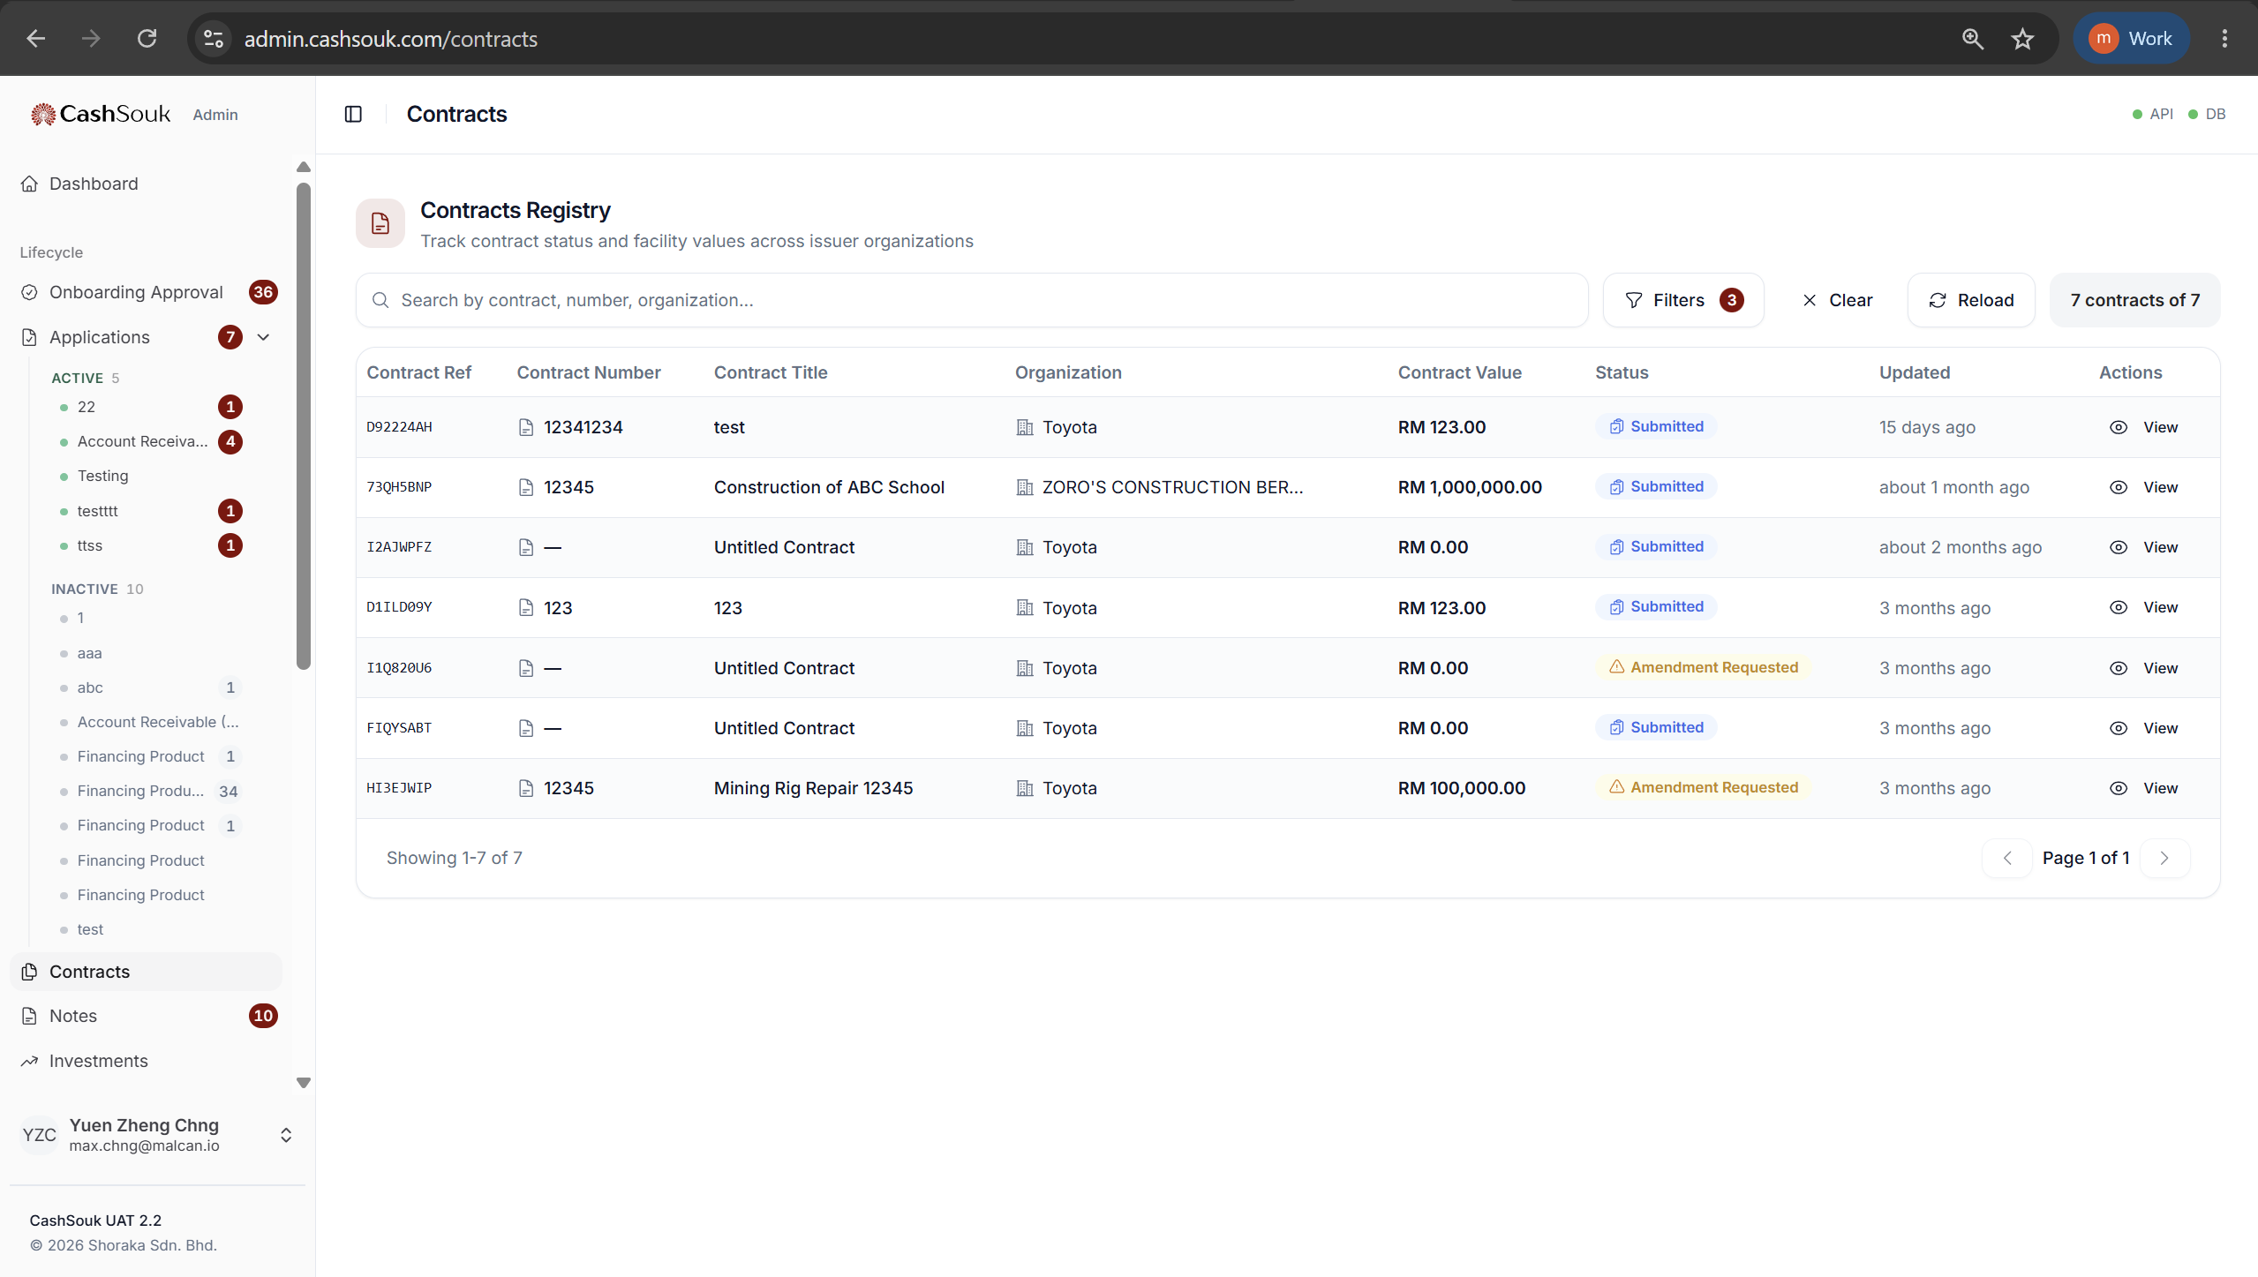
contracts.view

Slide 31
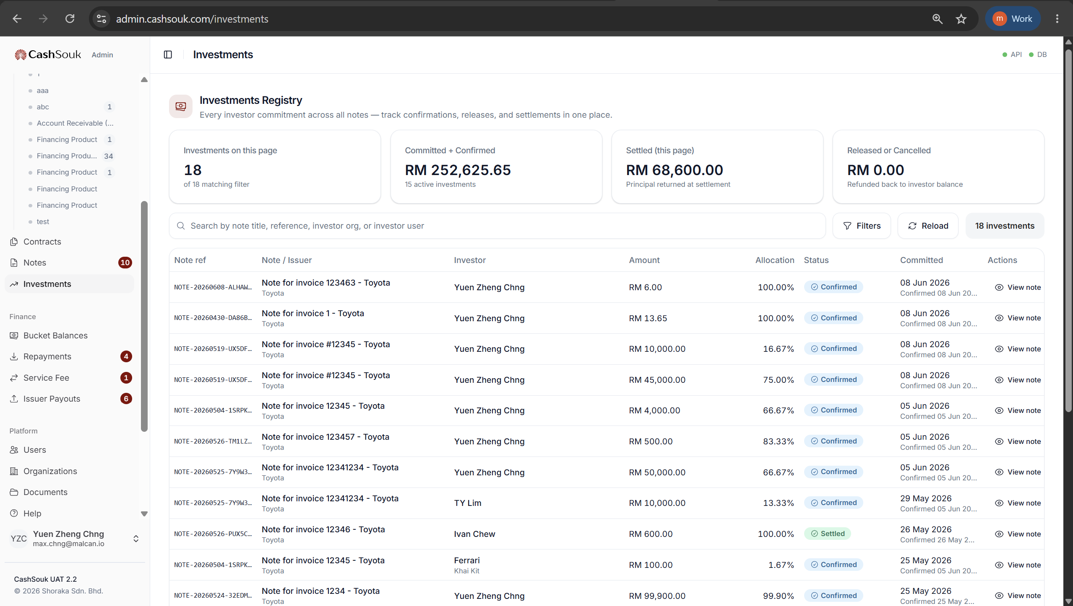
investments.view

Slide 32
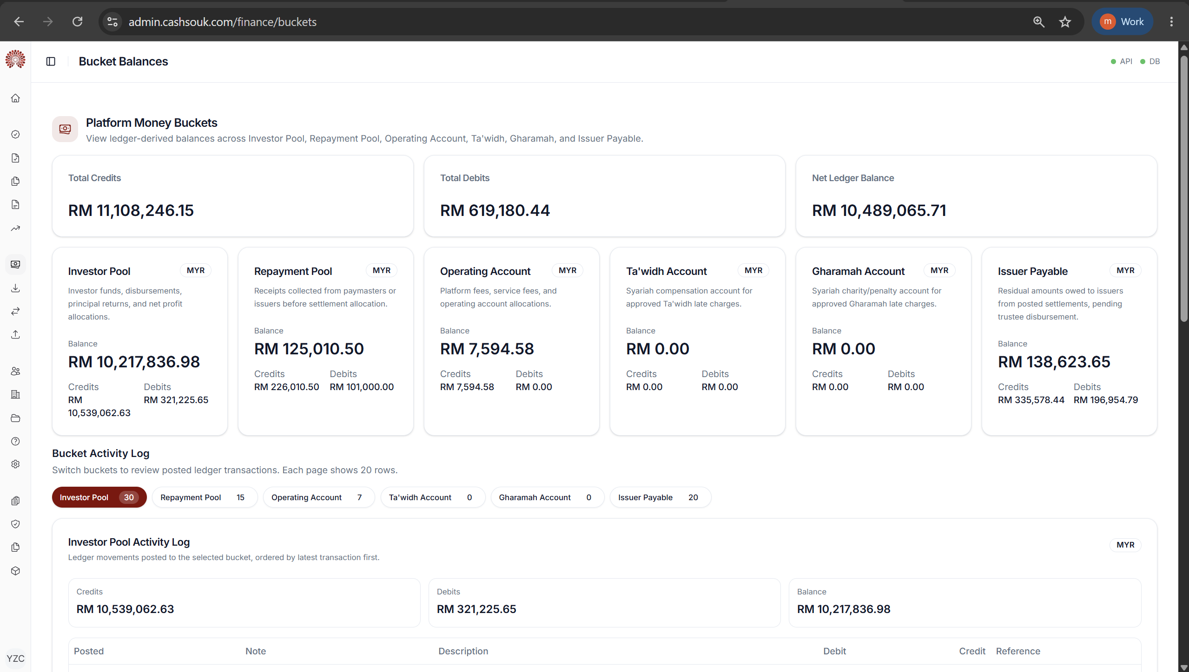
bucket_balances.view

Slide 33
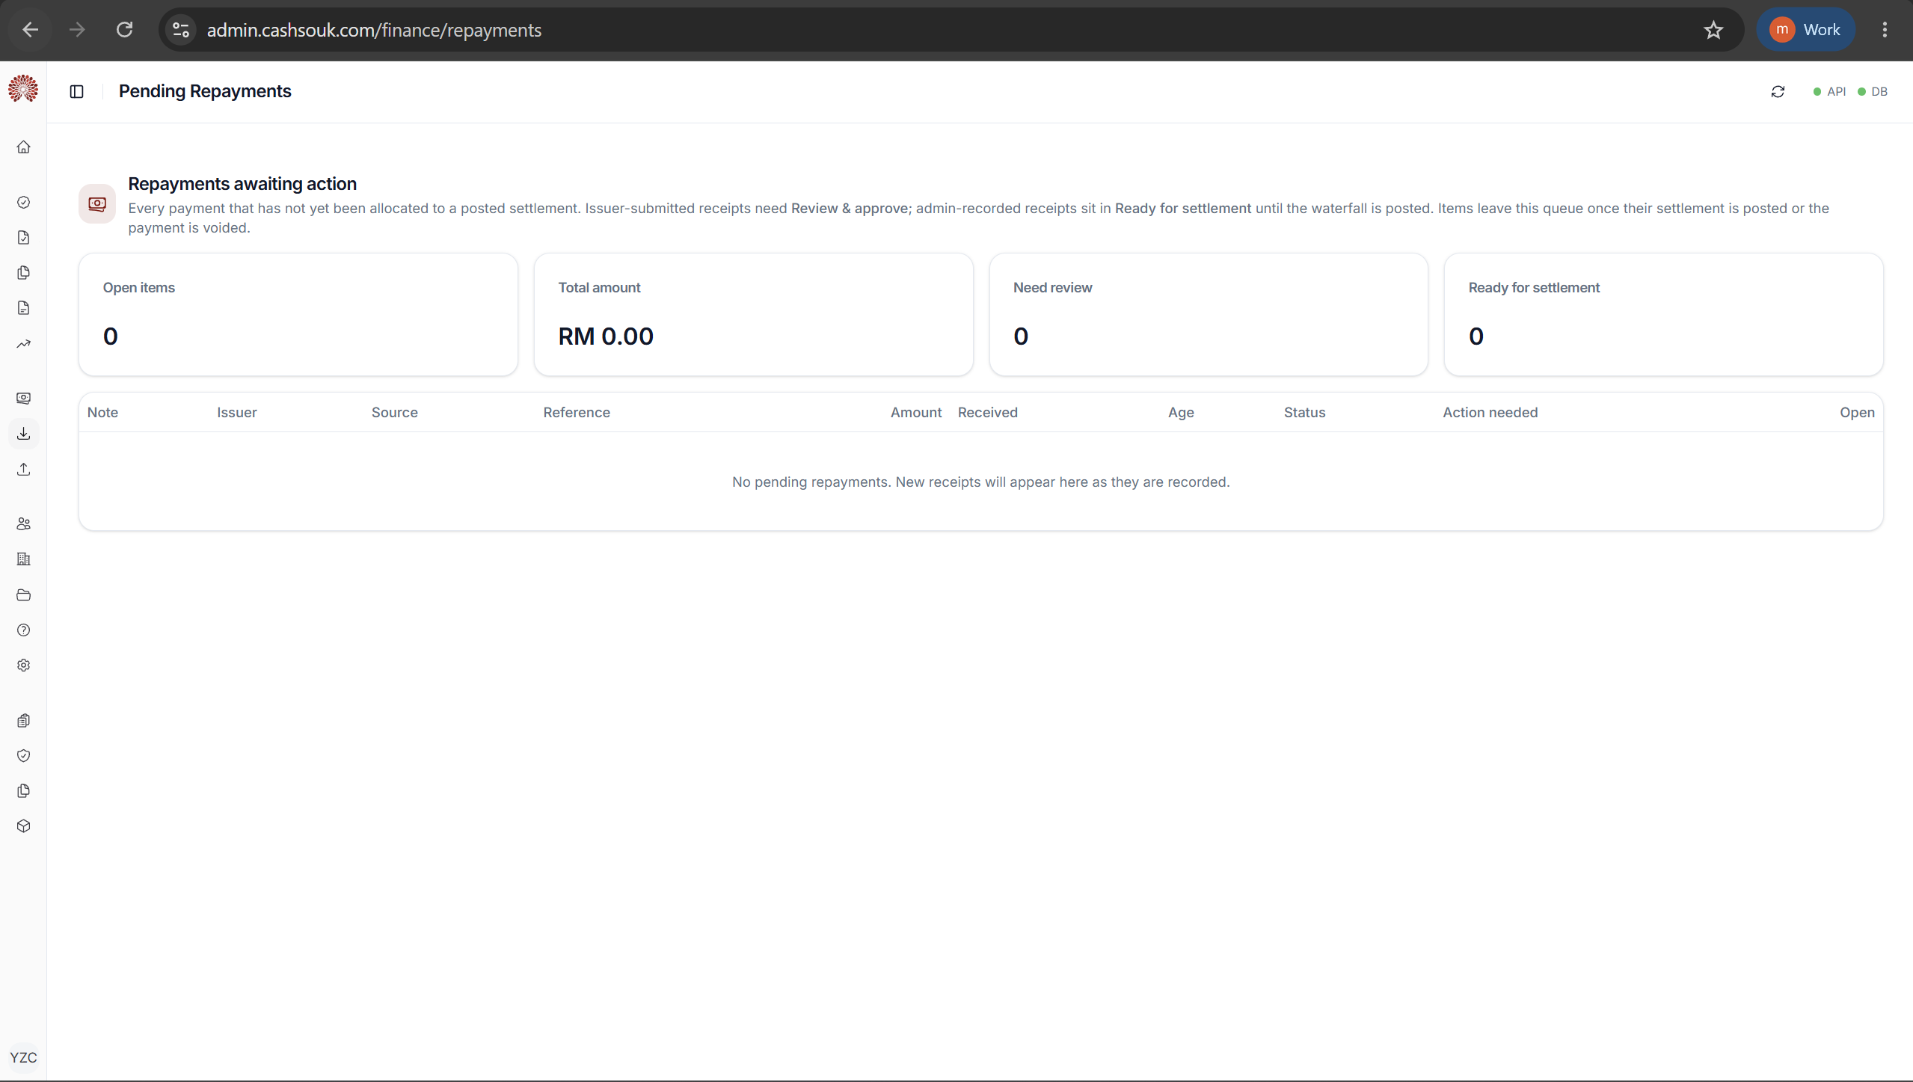
repayments.view

Slide 34
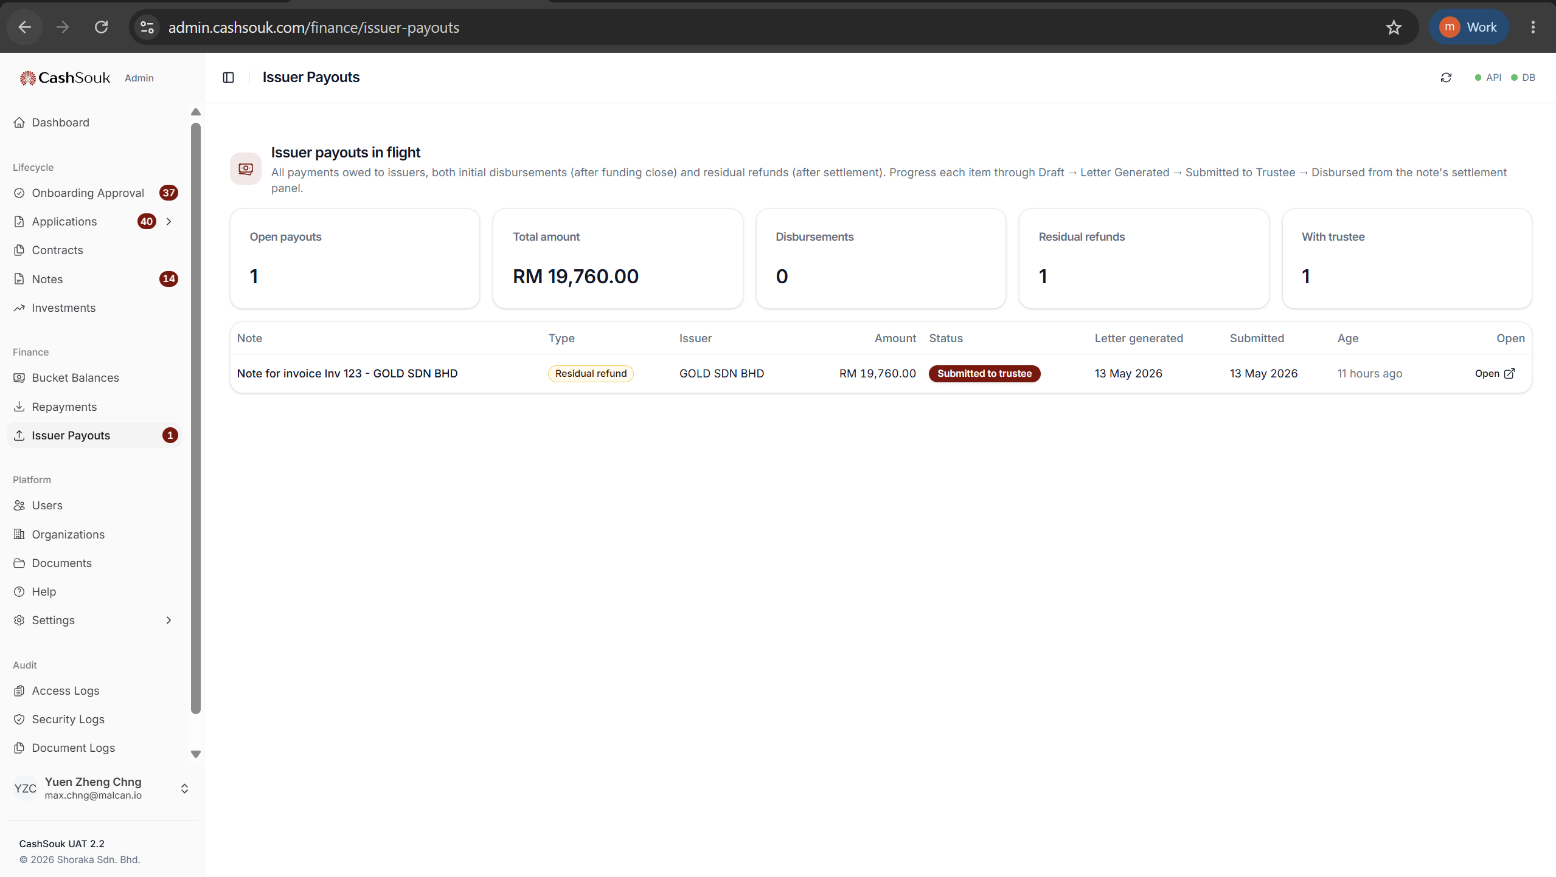
disbursements.view

Slide 35
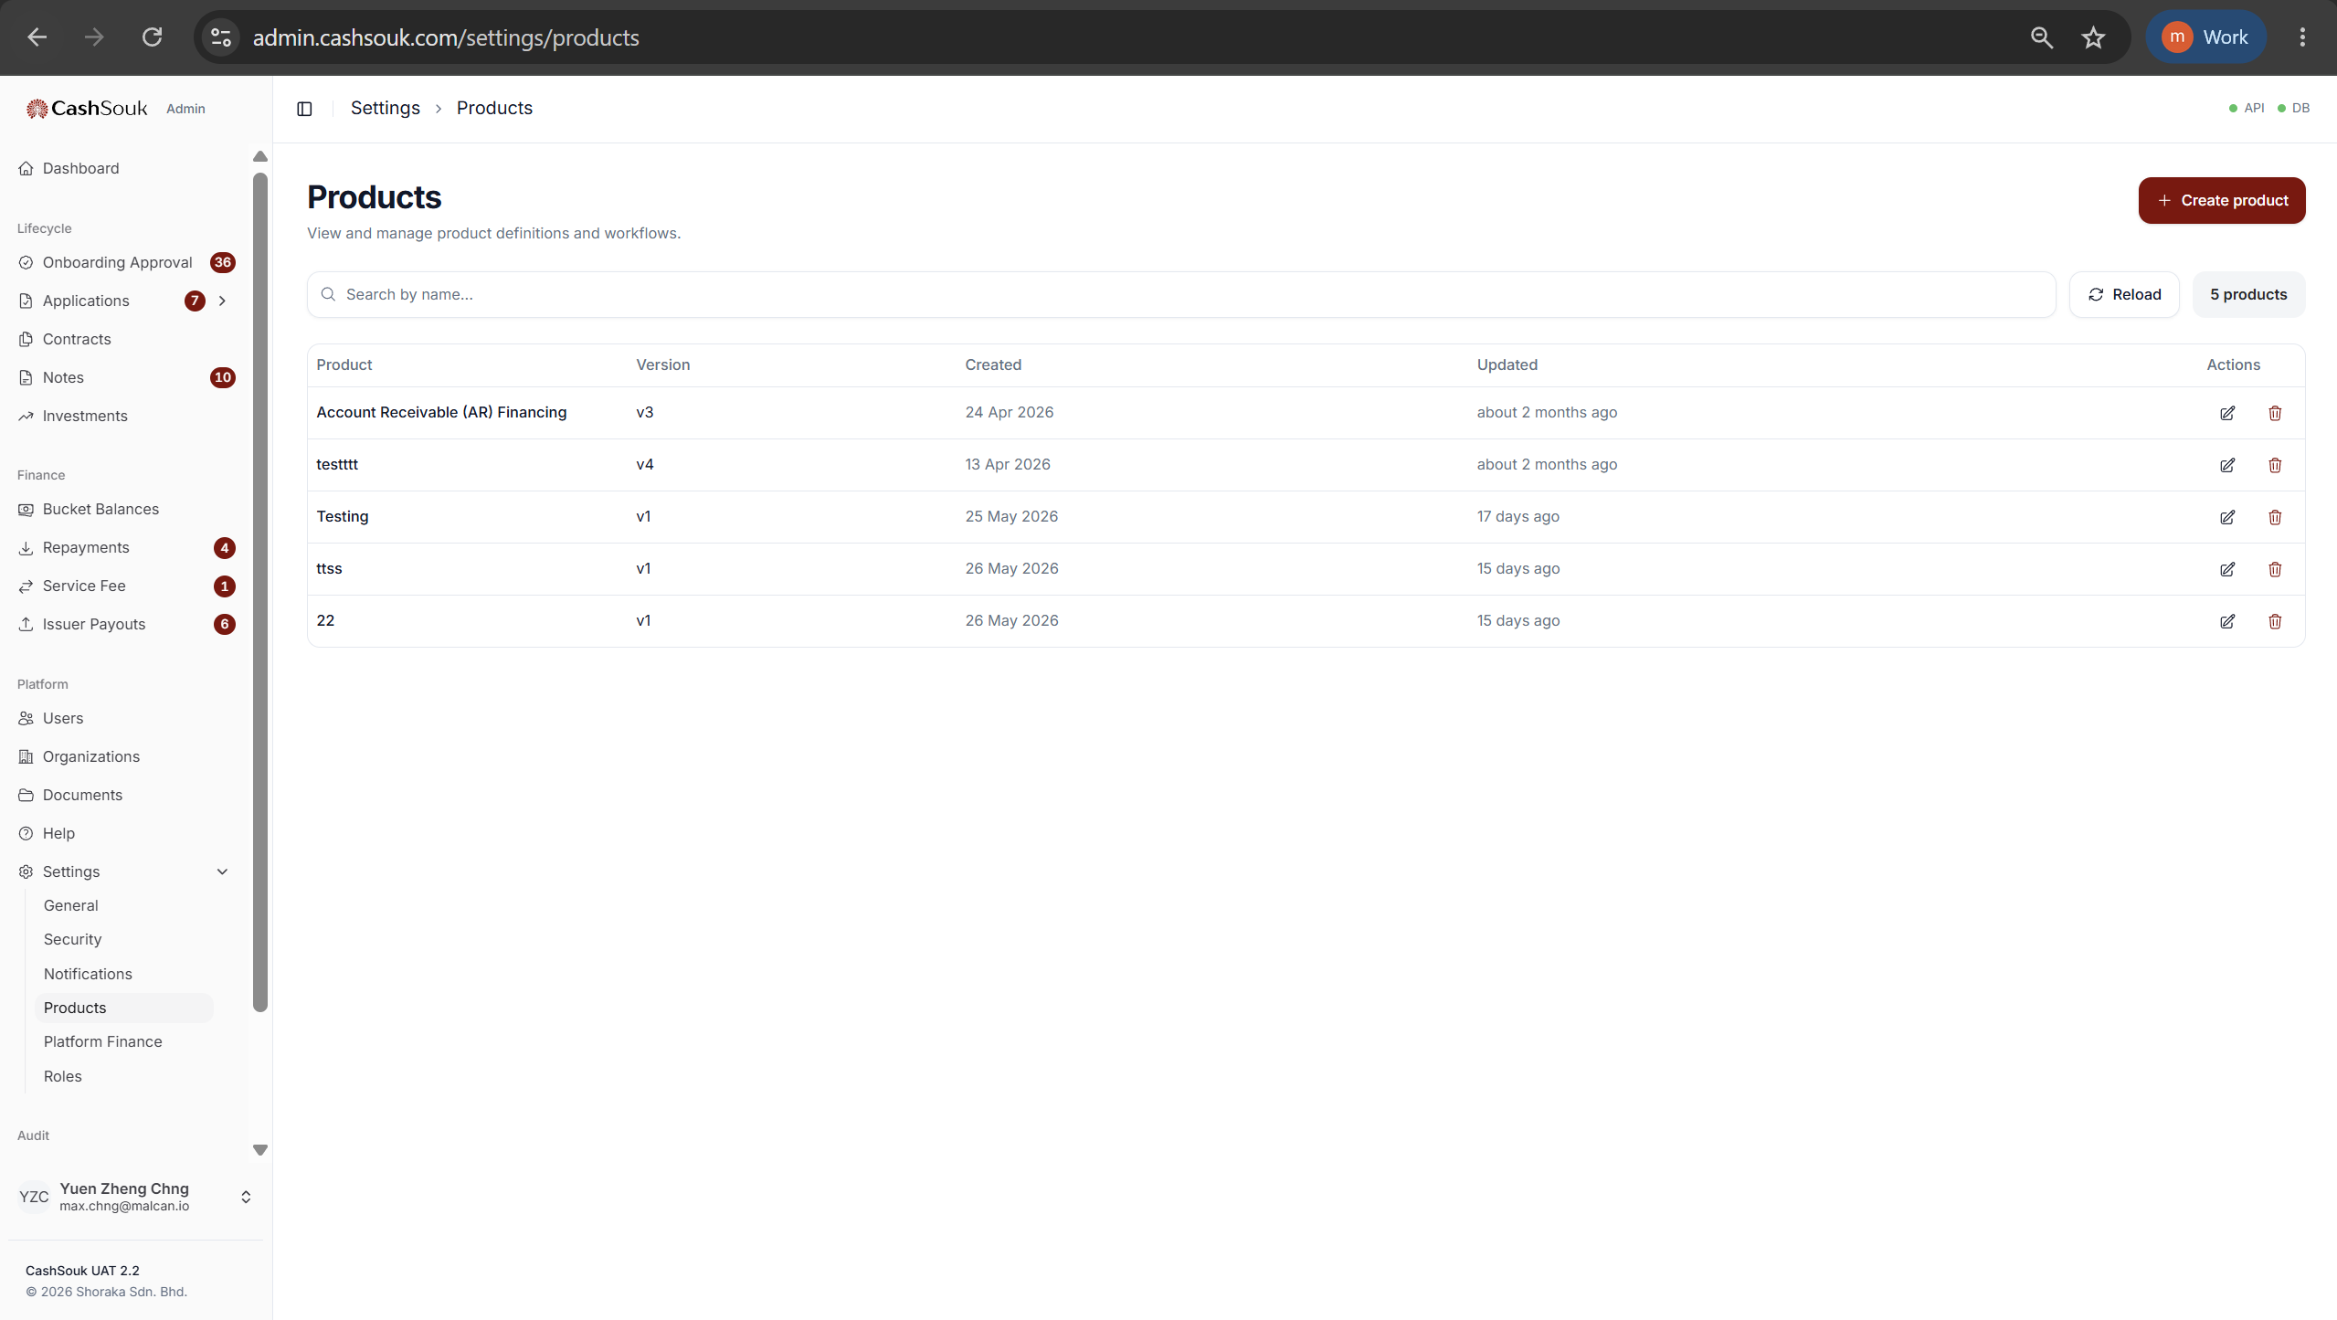
products.view
products.manage

Slide 36
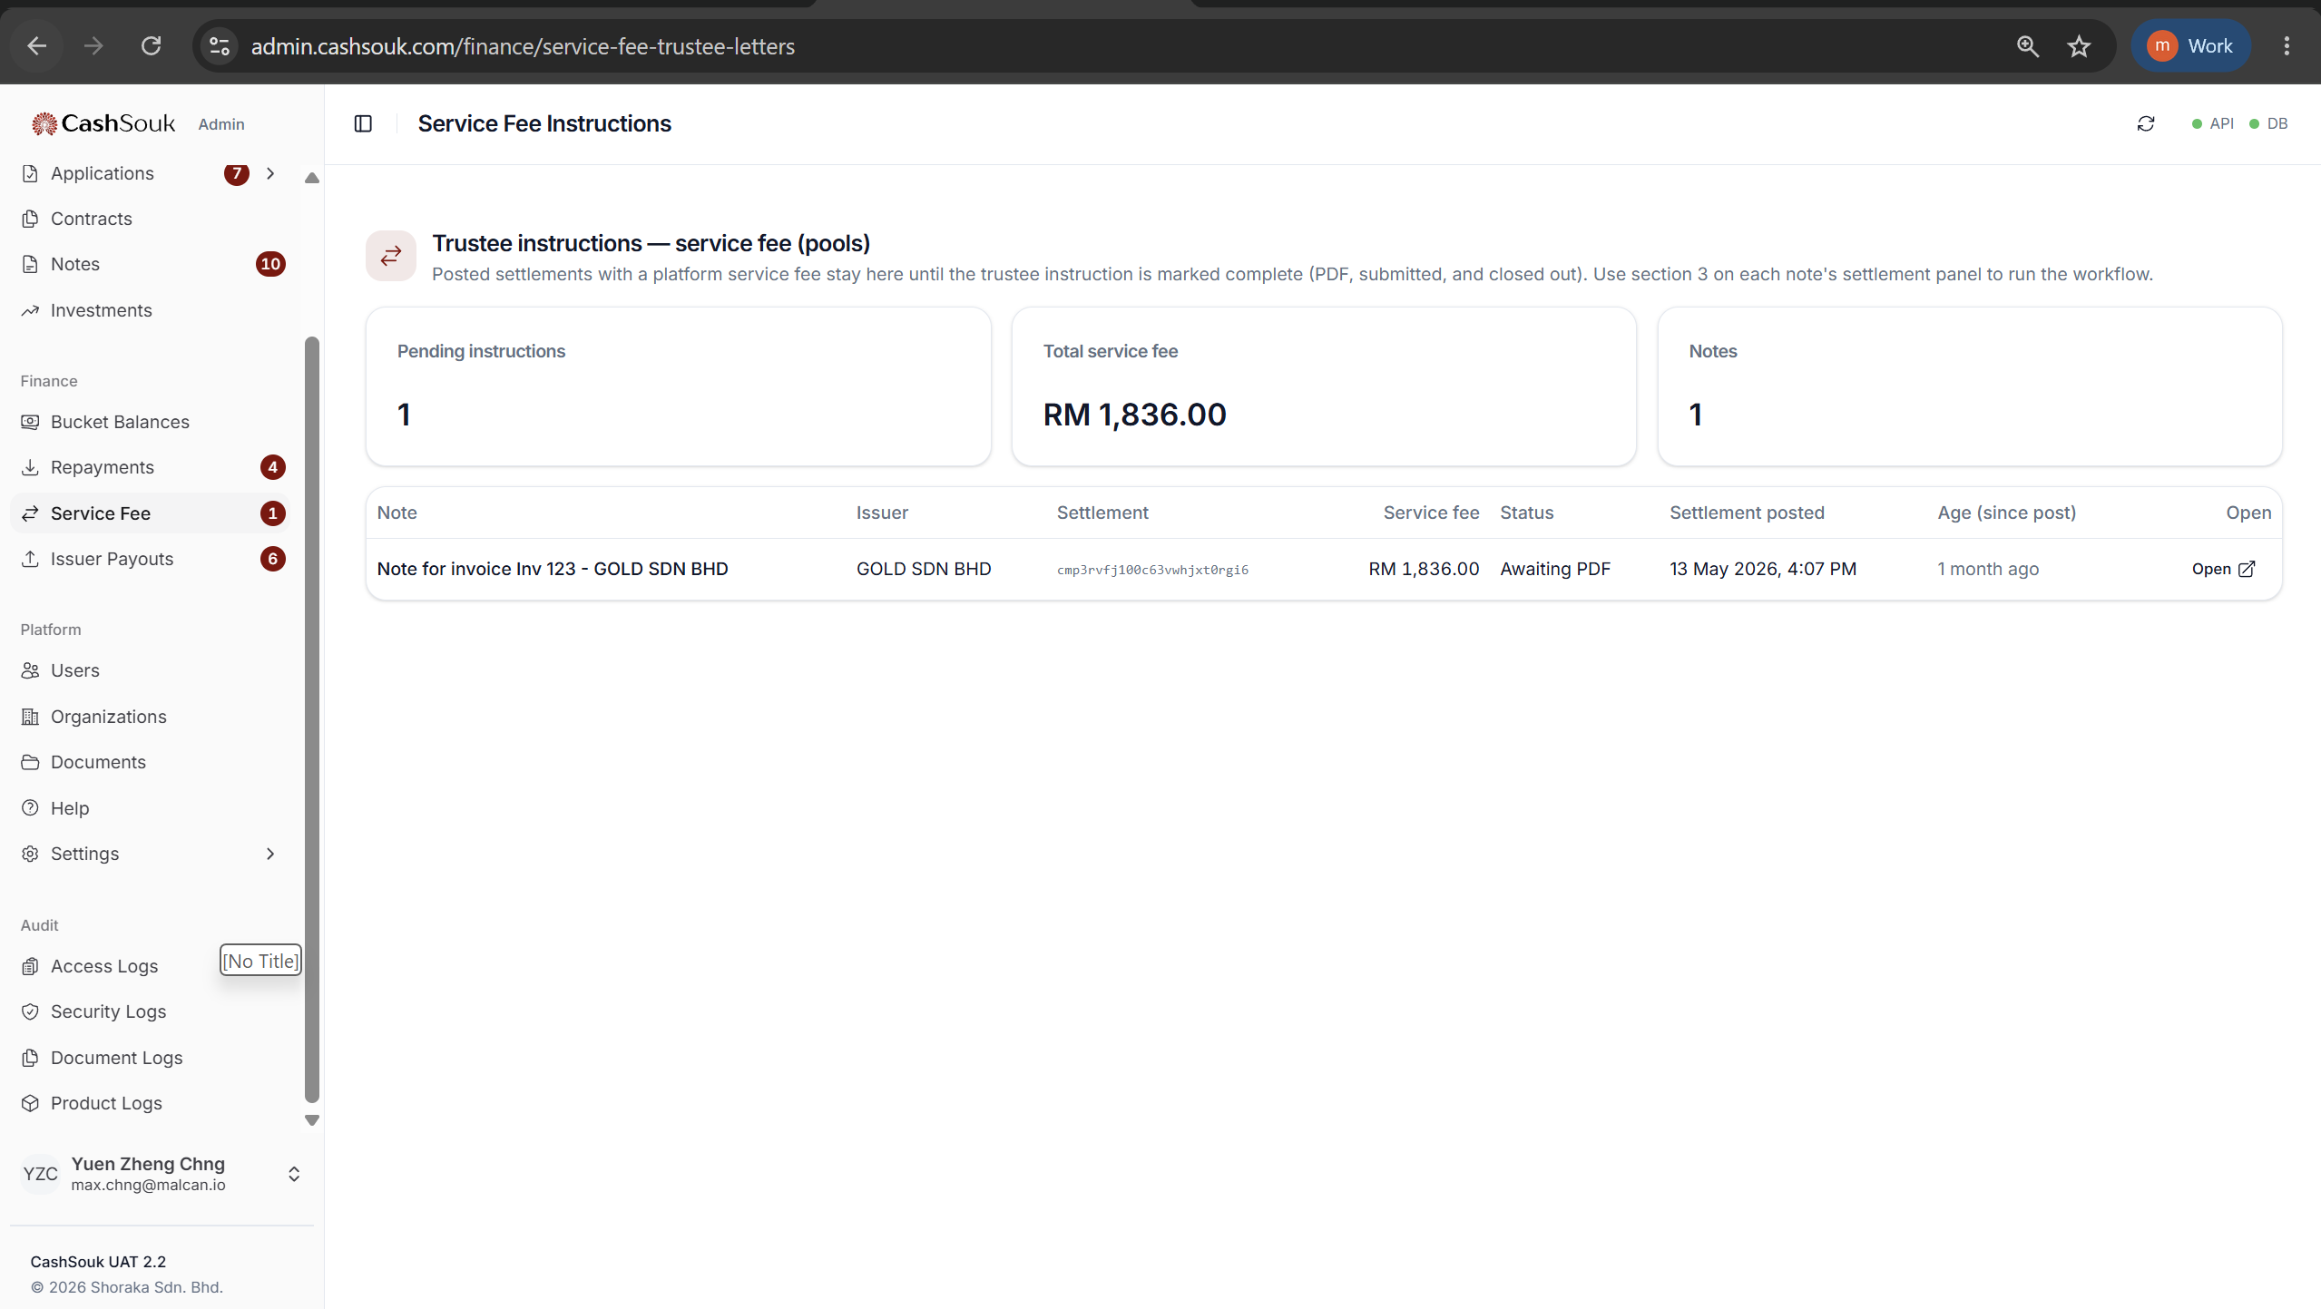
service_fee.view

Slide 37
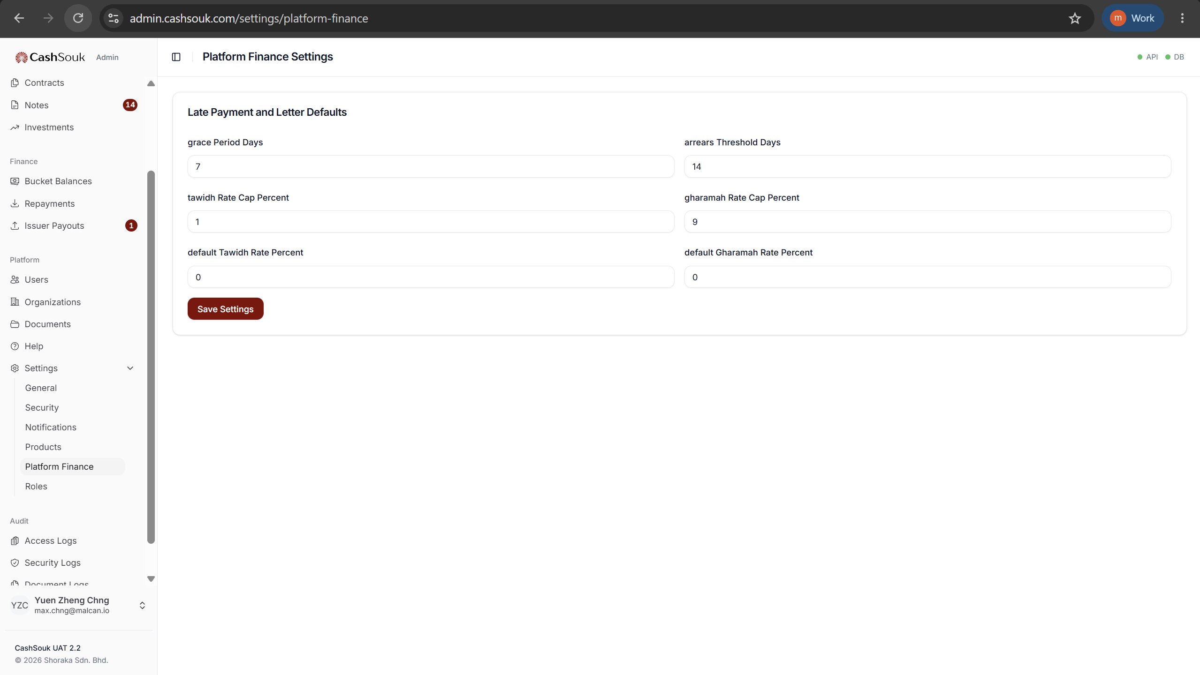
platform_settings.view
platform_settings.manage

Slide 38
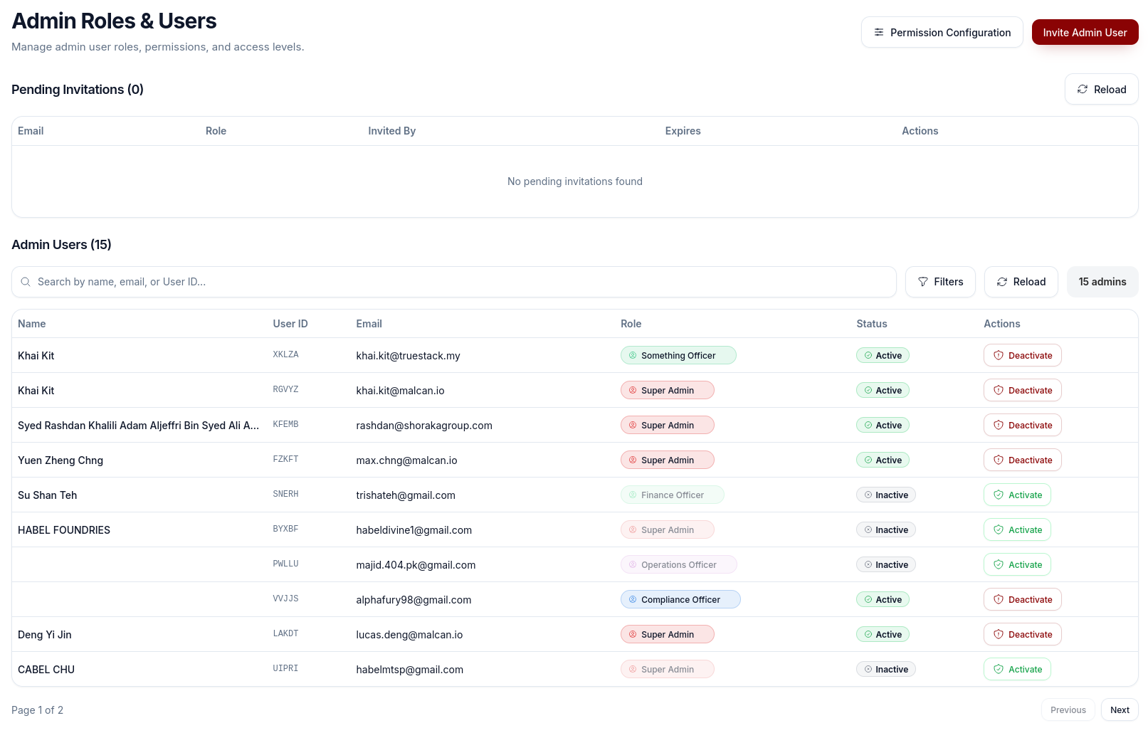
roles.view
roles.manage

Slide 39
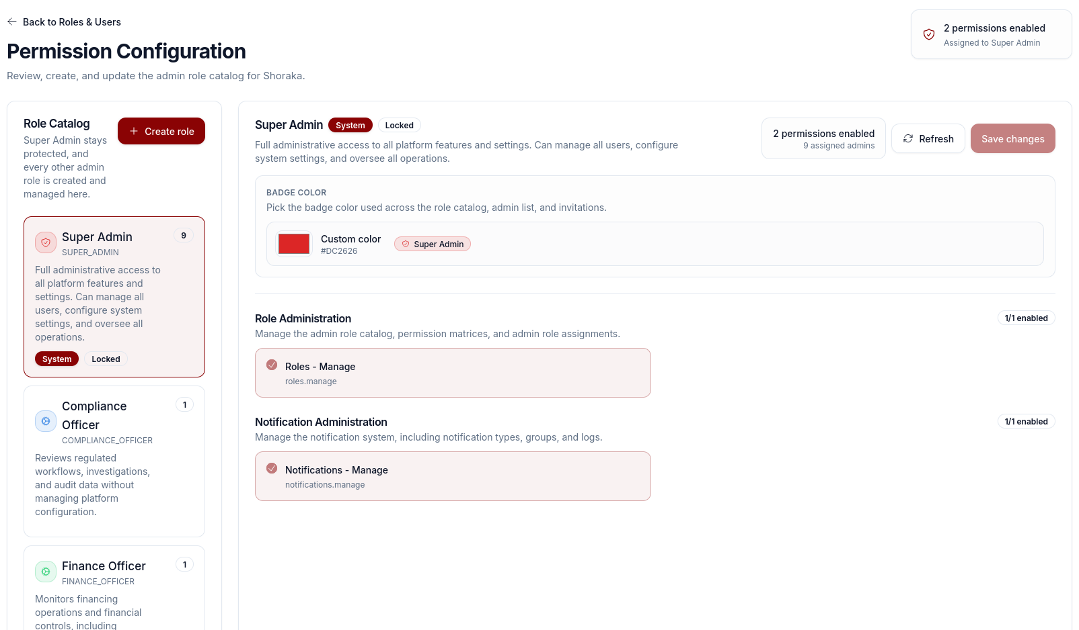
roles.view
roles.manage

Slide 40
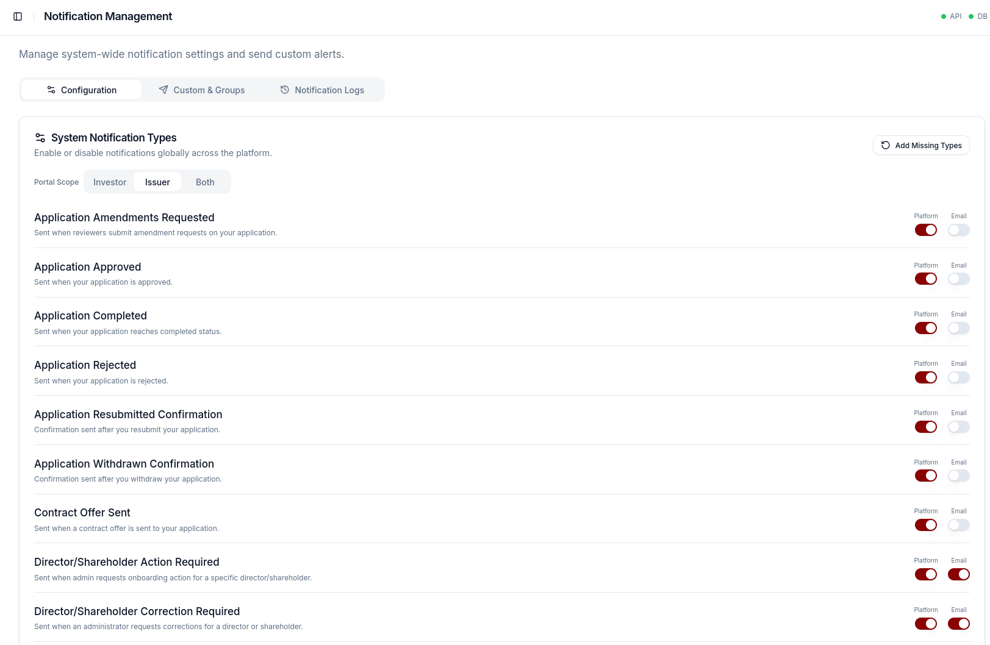
notifications.view
notifications.manage

Slide 41
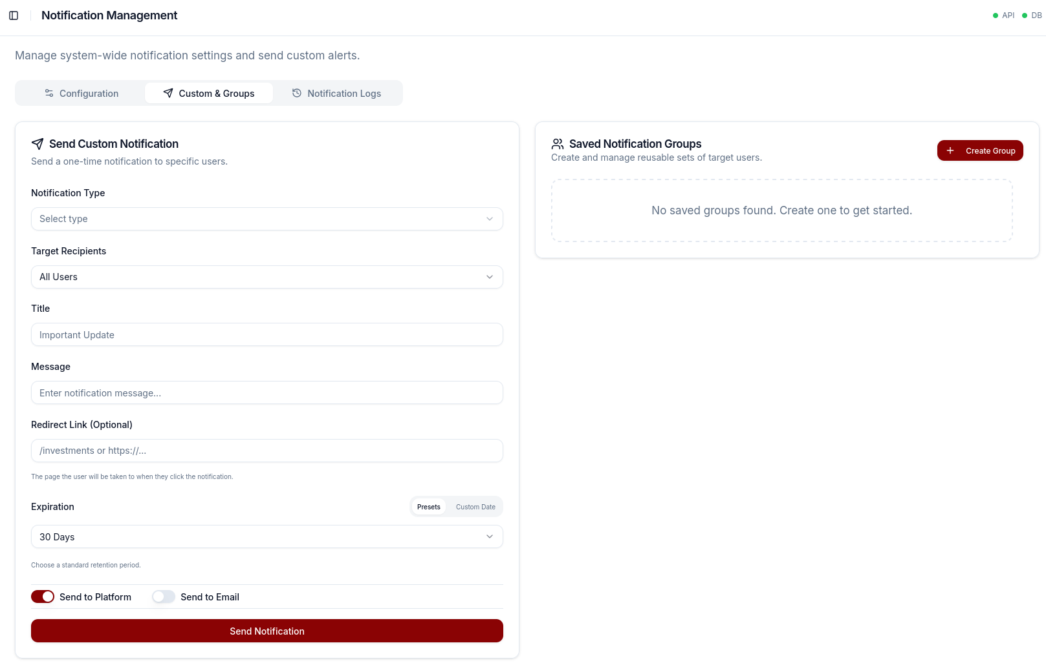
notifications.view
notifications.manage

Slide 42
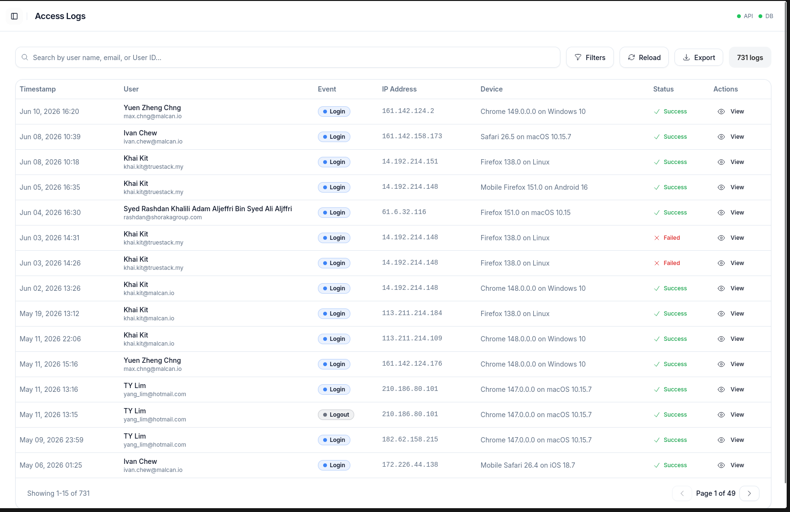
audit.access.view

Slide 43
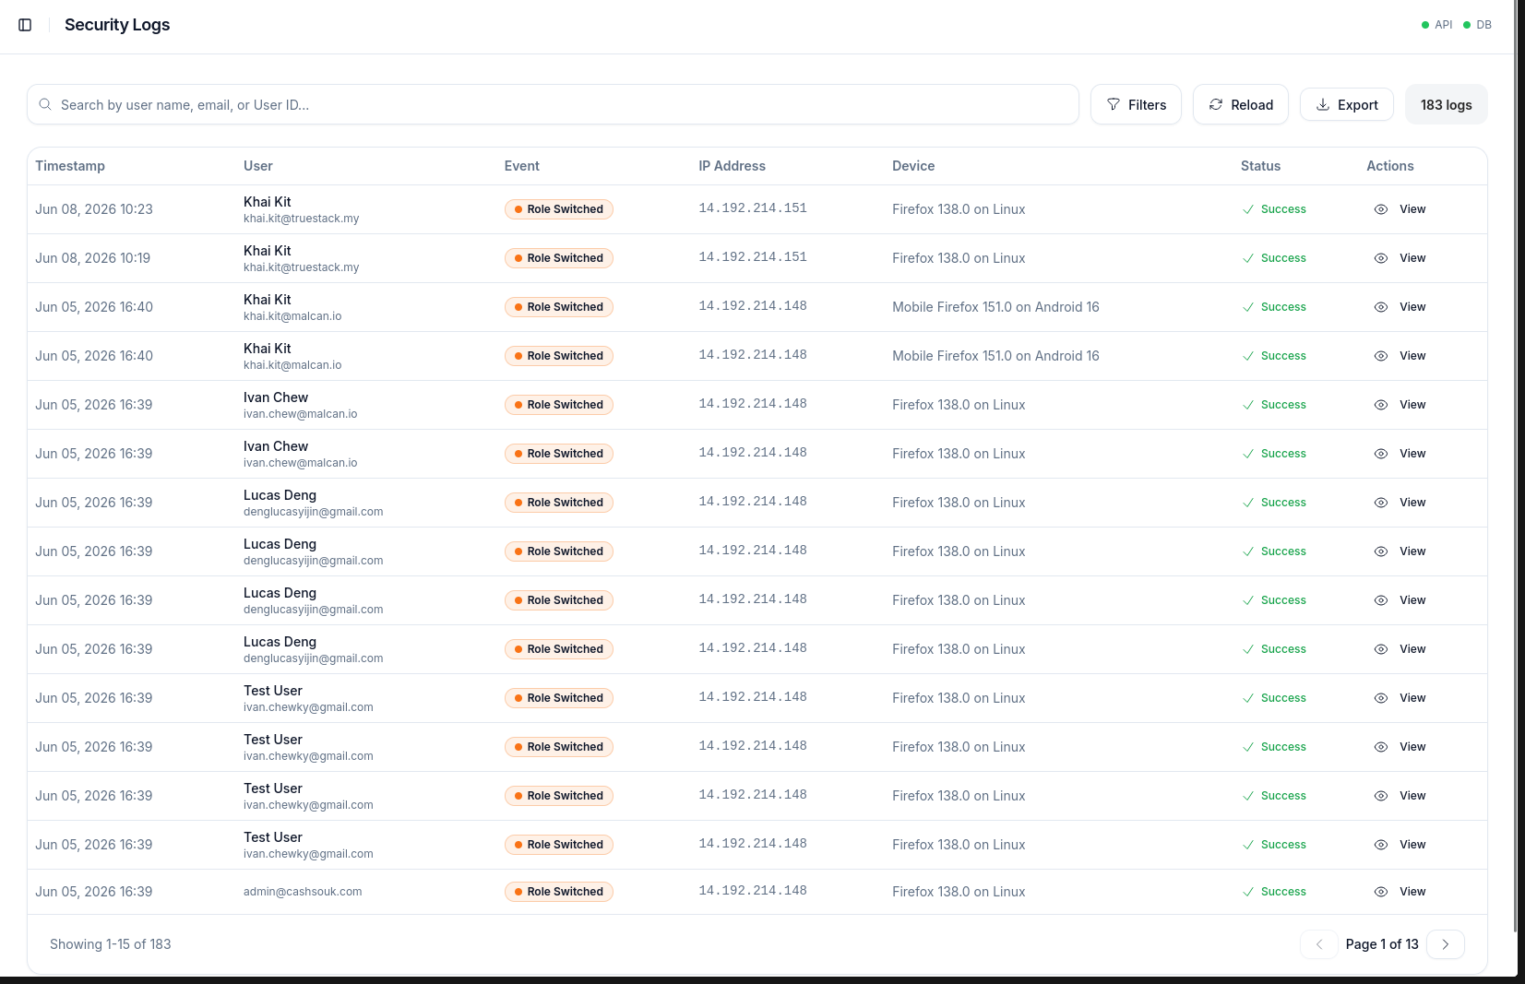
audit.security.view

Slide 44
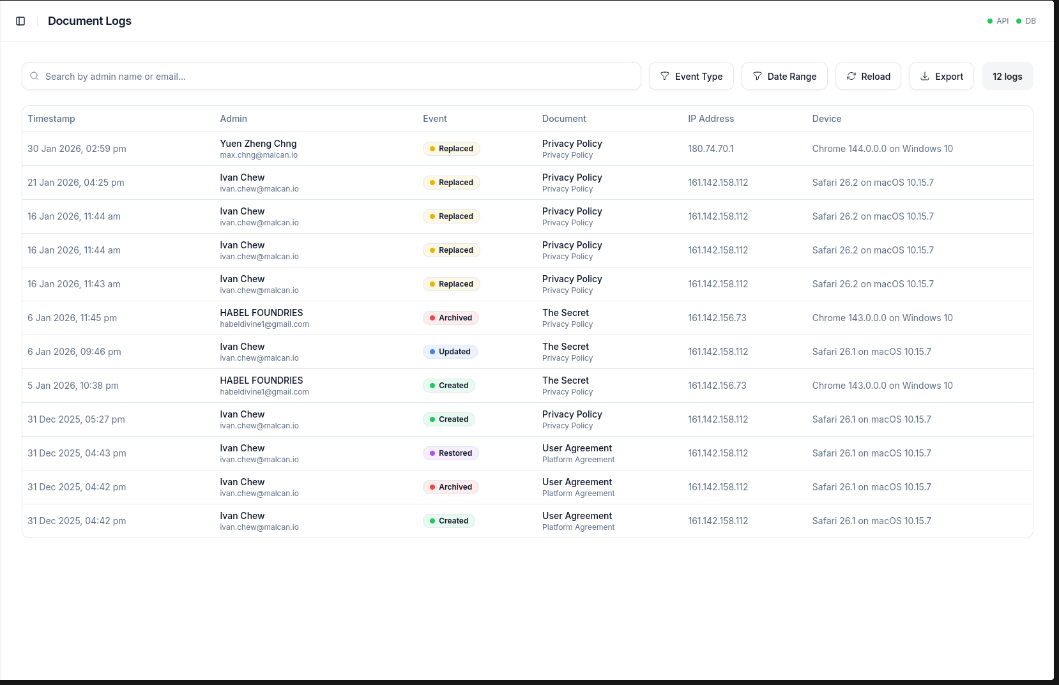
audit.document.view

Slide 45
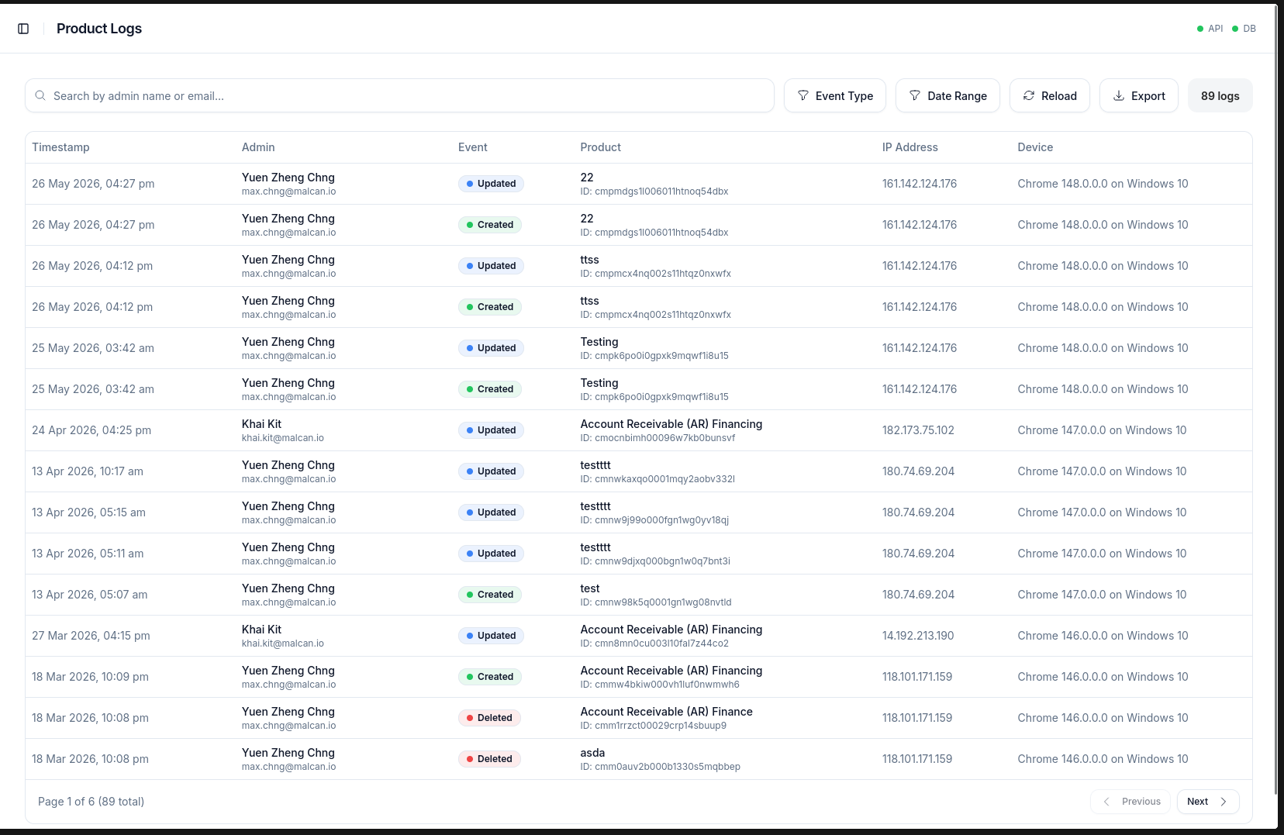
audit.product.view

Slide 46
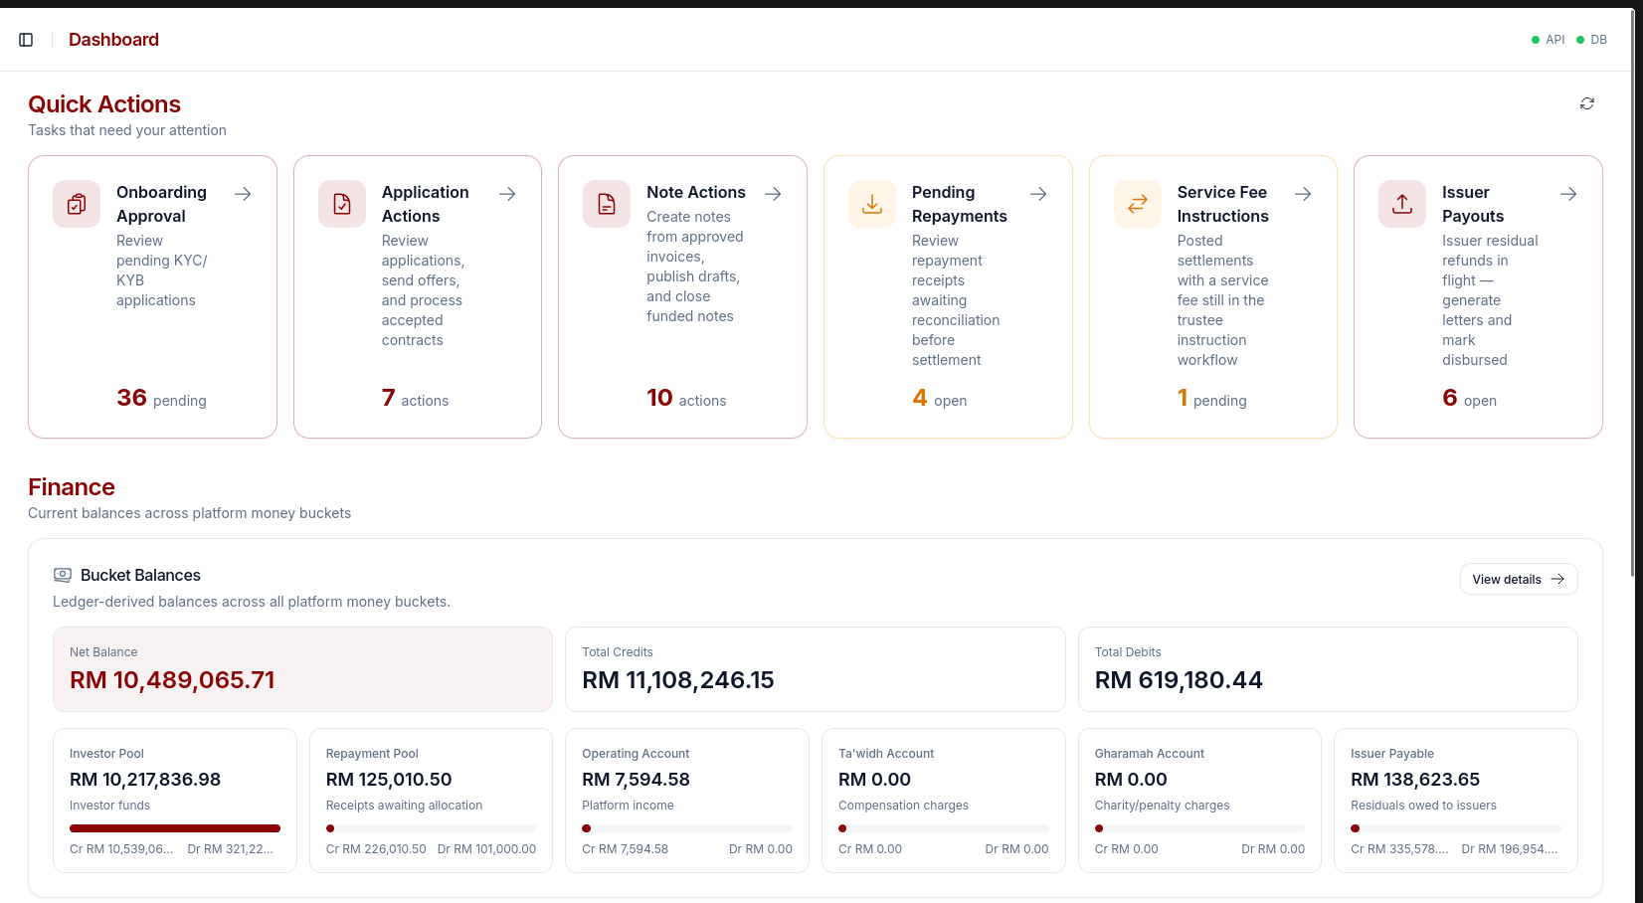
onboarding.view
applications.view
notes.view
repayments.view
service_fees.view
disbursements.view
dashboard.finance.view

Slide 47
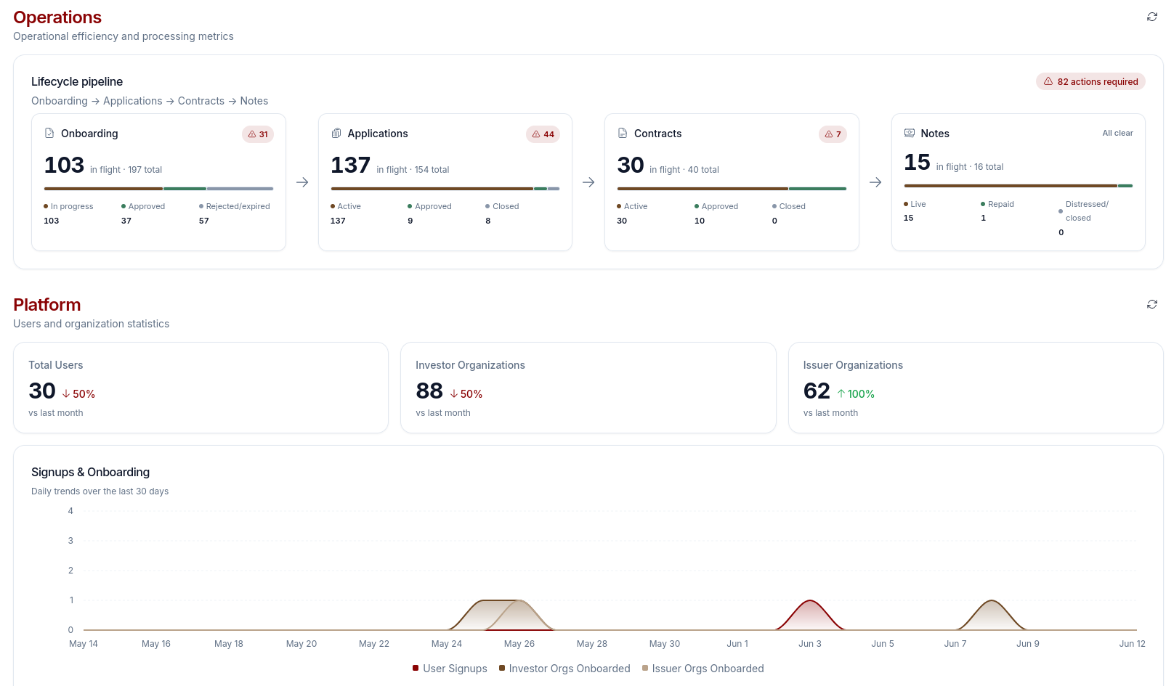
dashboard.operations.view
dashboard.platform.view

